Slide 1
Azure IoT Suite
L300 IoT Day
Igor Izotov
AWS CSA-Pro, MCSE
Recorded Version (Jan 2017) available here: https://aka.ms/iotclass-vid
Notes:
Azure IoT Technical Scenarios L300 – Connect and Manage IoT Devices Customer / Partner Ready

Slide 2
Ice Breaker
Name, Role and… Why are you here?
Rough timeline:
9:00 Start
10:00 – 10:15 Morning Coffee Break
12:00 – 13:00 Lunch
15:30 – 15:45 Afternoon Tea
17:00 – Wrap-up

Slide 3
Microsoft Azure IoT Business Scenario: IoT Phenomenon and IoT Business Maturity Model
Notes:
For a recorded presentation by Azure IoT Program Management through C+E University: IoT Online webinar series: please visit:
https://mspartnerlp.partner.microsoft.com/LearningPath/LearningPath/DLPaths?trackId=2918&rowId=3606&trackPathId=14612

Slide 4

25 BILLION Connected “things” will be in use by 2020
$7.2 TRILLION worldwide market for IoT solutions by 2020
IDC: Worldwide and Regional Internet of Things (IoT) 2014–2020 Forecast
Gartner
Notes:
Various estimates of market size and all of the large analyst firms are taking an active interest.
Discuss Gartner number
Over 3 connected things for every man, woman and child on earth
Discuss IDC number

Slide 5
IoT Business Maturity Model 1. Operational efficiency
Connect devices and monitor telemetry
Monitor and track device state, location and health
Things
Rules and alerting to improve operational efficiency
Notes:
Most customers adopting the IoT tend to follow a similar pattern.
- It starts with organizations hunting for operational efficiency.
- Subsequently they begin by connecting devices and capturing data. The cloud means that traditional concerns about ‘too much data’ are much less prevalent.
- Customers will be monitoring the IoT devices themselves and the things they they’re connected to.
Often customers will be using real time rules and alerting to make decisions in an ad hoc fashion about their things.

Slide 6
IoT Business Maturity Model 2. Business Intelligence
Analyze and visualize data from devices
Discover patterns in device data using predictive analytics
Things
Operationalize insights to improve things and processes in real time
Notes:
Next, organizations start to develop some business intelligence around the huge streams of data.
Once they’ve built a data set customers will start to derive insight from this. This moves from experimentation and exploration of data to insight, often using machine learning and other statistical and predictive models.
The cloud and predictive analytics work really well together. This is because predictive analytics requires a lot of computing power, which is ‘on tap’ in the cloud.
Insight allows customers to take better decisions as they run their business. Some of these will be real time operationalization of predictive models, some of these will be longer term strategic decisions.

Slide 7
IoT Business Maturity Model 3. Business Transformation
Combine IoT & other data with advanced analytics to power new services and revenue streams
Expand into new adjacent businesses
Things
New partnership opportunities
Notes:
Customers then integrate IoT into their broader business and explore new areas in which to deploy IoT solutions.
Data and devices in the field unlock new opportunities to partner with other organisations who’re also interested in the hardware platforms and data streams.
The cycle continues.

Slide 8


Slide 9
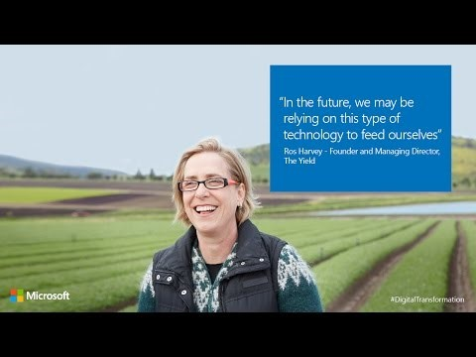

Slide 10


The connected cow: Using IoT to transform cattle production
CHALLENGE
SOLUTION
BENEFITS
Fujitsu is the world’s fourth-largest IT services provider with approximately 162,000 employees in more than 100 countries and holds about 97,000 patents worldwide. Fujitsu wanted to help dairy farmers increase production, improve data insights and transform their business by optimizing the timing of artificial insemination (AI). It also wanted to decrease loss through early detection of health issues.
Fujitsu learned from public research that a cow produces more estrus (goes into heat) 16 hours after the number of steps increases significantly. The company created an innovative solution which uses a rugged pedometer with a five-year battery to measure the number of footsteps a cow takes, then sends that data to the cloud for analysis to determine optimum AI timing and even affect calf gender. In addition, the patterns of steps can detect disease in cattle. Alerts are delivered to the farmer’s cell phone.
Improves calf production up to 31%, with an average of 12%
Modernizes data access with mobile phone alerts, reducing labor costs for monitoring cows
Transforms herd management by allowing farmers to increase chances of producing a male or female calf
Reduces loss by detecting 8-10 different kinds of diseases in cattle
FUJITSU
Notes:
Fujitsu in Japan have been working on a ‘smart cow’ solution.
Cows in the field are equipped with pedometers, similar to the wearables that we have.
The pedometer information is used to determine the best time for breeding.
This is allowing them to:
Significantly improve calf production
Detect disease early in the cow.
All case studies examined here can be found at www.InternetofYourThings.com
Now let’s get into having a look at Azure IoT Services and the Azure IoT Suite in a hands on fashion via the hands on labs.

Slide 11
Microsoft Azure IoT Technical Scenario: Connect, Manage and Scale with Efficiency Devices & Gateways
9:30
Notes:
For a recorded presentation by Azure IoT Program Management through C+E University: IoT Online webinar series: please visit:
https://mspartnerlp.partner.microsoft.com/LearningPath/LearningPath/DLPaths?trackId=2918&rowId=3606&trackPathId=14612

Slide 12
Hyper-Scale Azure footprint
38
Announced Azure regions worldwide
Hyper-Scale Capacity
3.5 Trillion Messages / Week
12
Azure IoT regions worldwide
Azure regions
Azure IoT regions
Notes:
Slide objective: Set context that Azure IoT is part of the HyperScale Azure platform with 38 Regions worldwide. Suite is available in many regions: US, Europe, APAC, Japan, Australia, Germany, China and we are extending the availability across other regions in CY17
Hyperscale, Hybrid, On-Prem: Microsoft Azure Stack is a new hybrid cloud platform that enables you to deliver Azure services from your own datacenter, You decide where to keep your data and applications—in your own datacenter or with a hosting service provider, available in Technical Preview 2.
Largest Compliance Portfolio in the Industry
Enterprise-Grade Security
Rich, Open Ecosystem

Slide 13





Elements of Azure IoT Suite
Connect and Manage Devices & Gateways
2. Analyze streaming data
3. Integrate into business systems
Preconfigured solutions
Real time analytics
Workflow integration
Devices & Gateway
Data visualization
Push and broadcast notifications
Connect and control
Predictive analytics*
ID and access management
4. Secure IoT Infrastructure
5. Customize IoT Architecture
* Only applies to Predictive Maintenance
Notes:
Slide Objective: Show that Microsoft Azure IoT is comprised of elements and underscore that his presentation is about first segment in a series of 5. Encourage audience to learn about the remaining 4.
Connect and manage devices and gateways
Preconfigured solutions offer quick start-up provisioning to the most common IoT scenario requirements.
Heterogeneous agents libraries, documentation and SDK’s allow for OS selection and cross platform, multi language support. Easily flash devices and create custom agents using open source libraries.
Connect and control devices easily, handling device authentication and secure two way communication.
Analyze streaming data and generate predictive insights
Set thresholds, alert limits and values and alarm jobs while processing big data.
Visualize big data on dashboards or create reports for business decision makers.
Implement predictive analytics and algorithms across historical and real time data for a variety of purposes.
Integrate and transform business processes
Integrate alarms, real time processes and elevate attention within new or existing line of business applications.
Broadcast notifications and commands to devices or personnel; utilize geographic or other custom features to target audiences.
c) Make dashboards and data available but control security and access to devices, thresholds and alert configurations.
Secure IoT Infrastructure
Protecting IoT solutions requires ensuring secure provisioning of devices, secure connectivity between these devices and the cloud, and secure data protection in the cloud during processing and storage. Working against such functionality, however, are resource-constrained devices, geographic distribution of deployments, and a large number of devices within a solution..
5) Customize IoT Architecture
Not everyone will want to or is positioned to avail of IoT Suite’s pre-configured solutions and will instead want to customize their IoT solution using individual services.

Slide 14
Elements of Azure IoT Suite
Connect and Manage Devices & Gateways
2. Analyze streaming data
3. Integrate into business systems
Preconfigured solutions
Real time analytics
Workflow integration
Devices & Gateway
Data visualization
Push and broadcast notifications
Connect and control
Predictive analytics*
ID and access management
4. Secure IoT Infrastructure
5. Customize IoT Architecture
* Only applies to Predictive Maintenance
Notes:
Slide objective: To clarify first the difference between Azure IoT Suite and preconfigured solutions

Slide 15
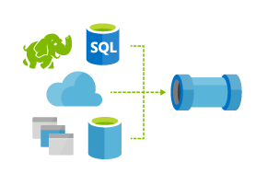
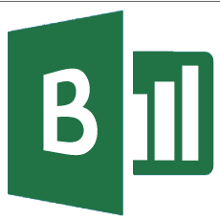
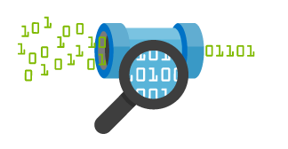


IoT Solutions
Azure IoT Solutions big picture
Cold Path Analytics
Azure HDInsight, AzureML
Azure Data Lake, Data Lake Analytics
Cloud Gateway
IoT Hub
Hot Path Analytics
Azure Stream Analytics, Azure HDInsight Storm
App Service, Websites
Logic Apps, BizTalk Services, Notification Hubs
Protocol Adaptation
Power BI
Hot Path Business Logic
Service Fabric & Actor Framework
Field Gateway
Protocol Adaptation
Devices
RTOS, Linux, Windows, Android, iOS
Field Gateway
Device
Connectivity & Management
Analytics &
Operationalized Insights
Presentation &
Business Connectivity
Notes:
Slide objective: Help audience visualize IoT solution architecture
Focus on Device Connectivity and Device Management and how heterogeneous devices from multiple platforms (RTOS, Linux, Windows, Android) are connecting to Azure IoT Hub either directly for greenfield devices or indirectly via Field Gateway for brownfield devices or via Protocol Adapter for devices which do not have native support AMQP/MQTT or HTTP protocols

Slide 16

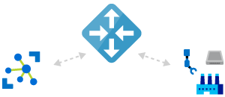
Overview Azure IoT Suite capabilities
Device Connectivity & Management
Gateway Edge intelligence
Data Ingestion and Command & Control
Stream Processing & Predictive Analytics
Workflow Automation and Integration
Dashboards and Visualization
Preconfigured Solutions
Remote Monitoring
Predictive Maintenance
Notes:
Slide objective: Make the distinction between Azure IoT Suite and Azure IoT Preconfigured solutions
Azure IoT Suite packages together multiple Azure services which are helping you to build an E2E IoT solution and this suite comes together with preconfigured solutions (or accelerators or short PCS) which are basic implementations of common IoT solution patterns that help you reduce the time to market .
We offer a broad spectrum of capabilities from device connectivity and device management offered by our SDKs, to gateway SDK support, to bi-directional communication with Azure IoT Hub, to real-time processing with Stream Analytics and HD Insight Storm & ML & Cognitive services, to workflow automation and integration with business connectivity with Logic Apps, to Power BI & App Service, to Azure IoT Preconfigured solutions, Remote Monitoring and Predictive Maintenance

Slide 17
Preconfigured solutions
Remote
Monitoring
Predictive
Maintenance
More to come…
Notes:
Transition to Preconfigured Solutions.

Slide 18
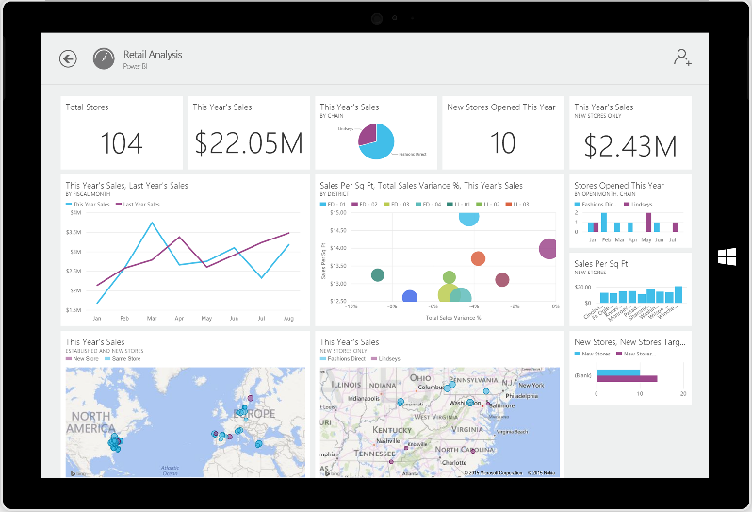
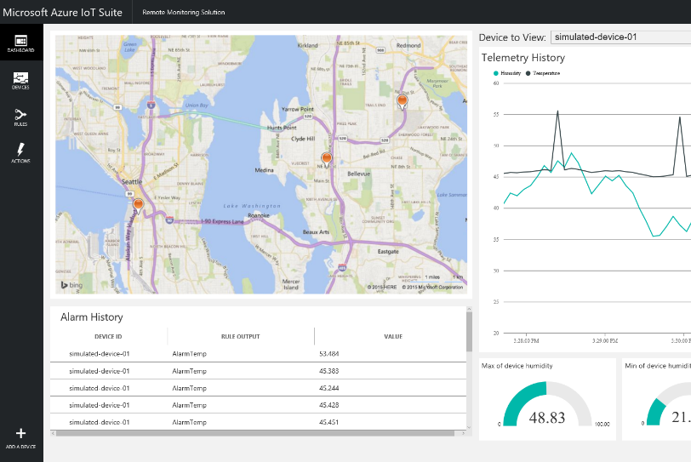
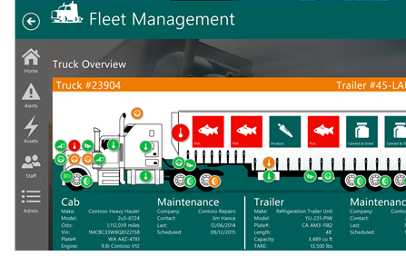
Preconfigured solutions
Remote Monitoring and Predictive Maintenance
Start quickly with preconfigured solutions
Finish with your Internet of Things application
Get started in minutes
Fine-tuned to specific assets and processes
Modify existing rules and alerts
Highly visual for your real-time operational data
Add your devices and begin tailor to your needs
Integrate with back-end systems
Notes:
Slide Objective: Why Preconfigured solutions
We’ve delivered these two solutions with 2 goals in mind:
Using the IoT certified kits you can customize and extend this code to meet your own requirements to showcase your solution
You can use these solutions as examples or templates when you are developing new IoT solutions.
From our open-source solutions, you could fine-tune them to specific assets and workflow processes and you could easily get to highly visual dashboards for real-time operational data, like for example a fleet management solution which monitors the truck components, cab, trailer and manages your maintenance schedules, vehicles, usage, work orders and much more.
We’ve listened to your feedback and we are currently working to deliver more production ready pre-configured solutions which will help you accelerate your time to market, so watch for our latest announcements.

Slide 19
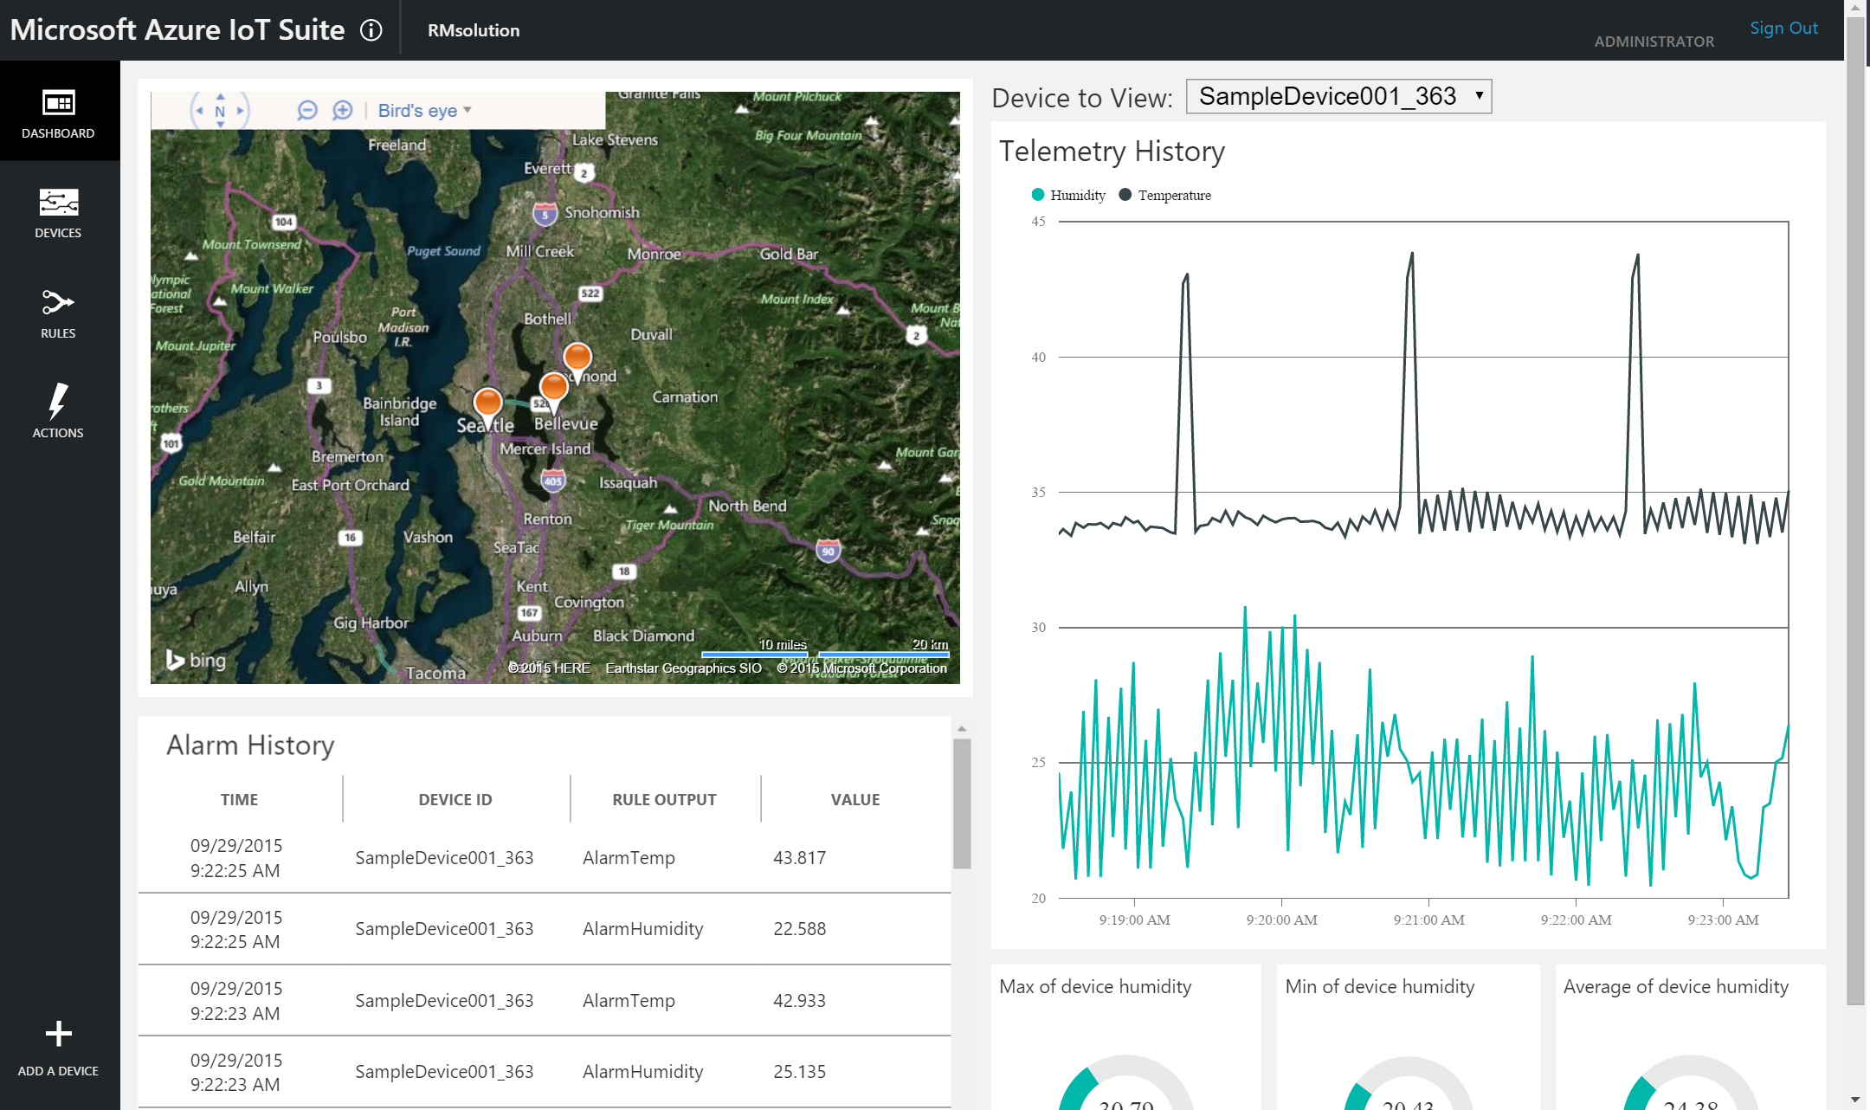
PCS: Remote Monitoring azureiotsuite.com
Notes:
Slide Objective: Show how to provision the Remote Monitoring preconfigured solution
To find about our PCS Go to azureiotsuite.com and you can select the type of solution you wish to deploy which is relevant to their requirements.
The provisioning portal is accessed through an active Microsoft Azure account, Provisioning should take around 10 minutes
The backend Azure services are automatically initiated and configured. Users can have multiple subscriptions for different requirements, or utilize different preconfigured solutions simultaneously depending on their needs.
RM is a implementation of an end-to-end monitoring solution for multiple machines running in remote locations. I will explain in a bit the logical architecture behind this solution
The solution subscription presents the user with an open source, fully customizable dashboard summary.
The Dashboard offers:
Real time data ingestion, command and control
KPI summaries/data visualization
Asset location, health and performance metrics

Slide 20
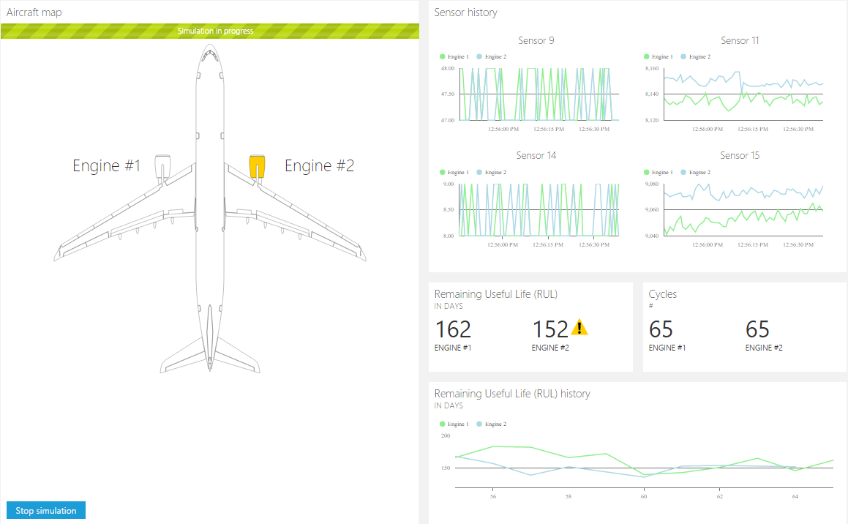
PCS: Predictive Maintenance azureiotsuite.com
Notes:
Slide Objective: Show how to provision the Remote Monitoring preconfigured solution
Predictive Maintenance can be selected as a solution from the Preconfigured Solutions menu page at azureiotsuite.com
The default dashboard for the predictive maintenance solution is as above. Like with remote monitoring, this is completely open source code that can be fully customized to fit the required solution. Selecting “Start simulation” will begin the “remaining useful life” calculations and prediction models for the built in solution. This solution out-of-the-box is based on predicting the remaining hours of service left on aircraft engines.
This solution is fully detailed on our webpage, please go ahead and explore it yourself, Rolls-Royce and other customers built a solution based on ours which optimizes and monitoring their airplane engine

Slide 21
What is behind IoT Suite preconfigured solutions
Azure IoT Suite Remote Monitoring and Predictive Maintenance*
Devices
Back end systems and processes
Azure IoT SDK (OSS)
Linux, RTOS,
mBed, Windows,
Android, iOS
Power BI
Web/ Mobile App
Storage blobs
DocumentDB
C# simulator
IoT Hub
Stream Analytics
Event Hub
Web Jobs
Logic Apps
* Azure ML
* Machine Learning available with Predictive Maintenance only
Notes:
Slide Objective: Show what’s ‘under the hood’ of a preconfigured solutions
How does it work? As mentioned; the solution is a combination of multiple back-end components. This architecture diagram shows the individual Microsoft products and services that are utilized.
Provision simulated devices with a C# device emulator running .Net. You could create agents for Linux, iOS, Android and other platforms with C and Java language support.
IoT Hub manages the two way communication between cloud and device and creates a secure command and control channel.
Azure Stream Analytics creates and manages jobs to recognize threshold values or detect alarm triggers, sending this information where it needs to be escalated.
Machine Learning solution enable powerful predictive analytics, leveraging historical data and real time device ingestion input.
Event Hub is queried by a web job running an event processor host to determine where an alarm or alert needs to be pushed – such as sending an alert to dashboard for a human operator to take action.
Logic Apps are used to create more complex work loads and integrate into line of business and other proprietary applications.
Document DB stores all the metadata and device properties for each connected device.
Blobs store telemetry information and telemetry data. Other tools such as Azure Machine Learning and PowerBI can access this information for data visualization or processing advanced analytics.
Webapp – Dashboard code is available in Github allowing it to be fully customized by the user to align with a scenario or be relevant for an enterprise application.
Azure Active Directory controls user ID’s and access, allowing the service to be shared with relevant decision makers within the business but restrict access to certain controls or devices.
PowerBI is used for both open-source embedded components within the dashboard and also for complex external analytics of trends and patterns across all stored data.

Slide 22
Hands-on Labs 0 & 1
Lab 0: Provision Environment (30 minutes). http://aka.ms/iotclass1
Concepts demonstrated:
Azure Portal
Creating a VM from the Marketplace
Lab 1: Remote Monitoring solution (45 minutes)
Concepts demonstrated:
Provisioning a preconfigured solution
Adding simulated and real devices
D2C
C2D
Creating Alerts
Solution Components
Resource Group
Azure Stream Analytics
Blob Storage
DocumentDB
10:15 – 11:30

Slide 23
Connect & Control Azure IoT Hub
11:35

Slide 24
Azure IoT Hub
Designed for IoT to multi-scale
Connect, monitor and manage millions of devices
Security
Individual device identities and credentials
Per-device security keys
X.509 via AMQPS/HTTPS/MQTTS
IP Filter to reject/accept specific IP addresses
Cloud-scale messaging
D2C, C2D, File transfer & Request/Reply methods
Durable messages
Device management: twin/methods/query/jobs
Declarative message routing
Cloud-facing feedback
Delivery receipts, expired messages
Device communication errors
Operations Monitoring
Monitor device connectivity and device identity management events
Connection multiplexing
Single device-cloud connection for all communications (C2D, D2C)
Multi-protocol
Natively supports AMQP, HTTP, MQTT
AMQP/MQTT over WebSocket
Designed for extensibility to custom protocols
Multi-platform
Device SDKs available for multiple platforms (e.g. RTOS, Linux, Windows, iOS, Android)
Multi-platform Service SDK
Notes:
Slide Objective: Provide an overview of IoT Hub
Azure IoT Hub is a fully managed service that enables reliable and secure bidirectional communications between millions of IoT devices and a solution backend
Enables secure communications and access control using per-device security keys (or security tokens) or X.509 certificates.
IoT Hub uses security tokens to authenticate devices and services to avoid sending keys over the network. Additionally, security tokens are limited in time validity and scope. Azure IoT SDKs automatically generate tokens without requiring any special configuration.
X.509-based authentication allows authentication of an IoT device at the physical layer as part of the TLS connection establishment. The choice between the two methods is primarily dictated by how secure the device authentication needs to be, and availability of secure storage on the device (to store the private key securely).
Because security is an important aspect of an IoT solution, sometimes you might need to blacklist or whitelist certain IP addresses as part of your security configuration. The IP filter feature enables you to configure rules for rejecting or accepting traffic from specific IPv4 addresses.
Provides multiple device-to-cloud and cloud-to-device communication options, file transfer for cold data, and request-reply methods
D2C messages are durable and retained in an IoT hub's default messages/events endpoint for up to seven days
Provides a queryable store for device metadata and synchronized state information via twin, jobs provided by device management
Provides declarative message routing to other Azure services based on message properties to redirect telemetry messages to different cloud endpoints: critical queue for alarms, Stream Analytics / Storm for hot path analytic and Storage/Data Lake for cold path
Every C2D message has an expiration time and the service can request the delivery of per-message feedback regarding the final state of that message.
Provides extensive monitoring for device connectivity and device identity management events. IoT Hub monitors 6 category of events: Device identity operations, Device telemetry, Cloud-to-device messages, Connections, File uploads, Message routing
We support connection multiplexing across devices.
Using multiplexing you will increase the performance by reusing the same D2C connection for all communication
Supports multi-protocol, natively supports AMQP/HTTP/MQTT and AMQP/MQTT over Websockets, which is of benefit for those environments which block non-web Internet connections using a firewall
Includes device libraries for the most popular languages and platforms and we’ll talk later about these

Slide 25
IoT Hub endpoints
MQTT, MQTT-WS, AMQP, AMQP-WS, HTTP
AMQP
Device
IoT Hub
Event processing
(hot and cold path)
Device id
D2C receive endpoint
D2C send endpoint
C2D receive
endpoint
C2D
send endpoint,
receive delivery ack
Twin endpoint
Device provisioning and authorization
myiothub.azure-device.net
Device identity management
Methods
endpoint
Device management, device business logic,
Connectivity monitoring
Receive file notification
File upload
endpoint
Field GW /
Cloud GW
Device Twins endpoint
Device…
Direct Methods endpoint
Device …
Job
management
IoT Hub management
Create and delete IoT hubs, and update IoT hub properties, export device identities
AMQP
Notes:
Slide Objective: Illustrate how IoT Hub exposes a set of endpoints to access its functionalities.
On the left side, we have device endpoints and on the right side we have service endpoints. Let’s talk now about device endpoints, so the left ones
Send device-to-cloud messages. Use this endpoint to send device-to-cloud messages.
Receive cloud-to-device messages. A device uses this endpoint to receive targeted cloud-to-device messages.
Retrieve and update device twin properties. A device uses this endpoint to access its device twin's properties.
Receive direct methods requests. A device uses this endpoint to listen to direct methods's requests.
Initiate file uploads. A device uses this endpoint to receive an Azure Storage SAS URI from IoT Hub to upload a file.
On the right side we have following service endpoints
Receive device-to-cloud messages. This endpoint is compatible with Azure Event Hubs. A back-end service can use it to read all the device-to-cloud messages sent by your devices. You can add custom routing endpoints to your IoT hub in addition to this endpoint.
Send cloud-to-device messages and receive delivery acknowledgments. These endpoints enable your solution back end to send reliable cloud-to-device messages, and to receive the corresponding delivery or expiration acknowledgments.
Device identity management. Each IoT hub exposes a set of HTTP REST endpoints to manage device identities (create, retrieve, update, and delete). Device identities are used for device authentication and access control.
Receive file notifications. This messaging endpoint allows you to receive notifications of when your devices successfully upload a file.
Device twin management. Each IoT hub exposes a set of service-facing HTTP REST endpoint to query and update device twins (update tags and properties).
Direct method invocation. This endpoint allows a back-end service to invoke a direct method on a device.
Jobs management. Each IoT hub exposes a set of service-facing HTTP REST endpoint to query and manage jobs
Finally, the IoT Hub resource provider exposes an Azure Resource Manager interface that enables Azure subscription owners to create and delete IoT hubs, and update IoT hub properties. IoT Hub properties govern hub-level security policies, as opposed to device-level access control, and functional options for cloud-to-device and device-to-cloud messaging. The IoT Hub resource provider also enables you to export device identities.

Slide 26
Connectivity – Protocols
Protocol | When you should choose this protocol
MQTT MQTT over WebSockets | Use on all devices that do not require to connect multiple devices (each with its own per-device credentials) over the same TLS connection.
AMQP AMQP over WebSockets | Use on field and cloud gateways to take advantage of connection multiplexing across devices.
HTTP | Use for devices that cannot support other protocols.
Notes:
Cloud-to-device pattern. HTTP does not have an efficient way to implement server push. As such, when you are using HTTP, devices poll IoT Hub for cloud-to-device messages. This approach is inefficient for both the device and IoT Hub. Under current HTTP guidelines, each device should poll for messages every 25 minutes or more. On the other hand, MQTT and AMQP support server push when receiving cloud-to-device messages. They enable immediate pushes of messages from IoT Hub to the device. If delivery latency is a concern, MQTT or AMQP are the best protocols to use. For rarely connected devices, HTTP works as well.
Field gateways. When using MQTT and HTTP, you cannot connect multiple devices (each with its own per-device credentials) using the same TLS connection. Thus, for Field gateway scenarios, these protocols are suboptimal because they require one TLS connection between the field gateway and IoT Hub for each device connected to the field gateway.
Low resource devices. The MQTT and HTTP libraries have a smaller footprint than the AMQP libraries. As such, if the device has limited resources (for example, less than 1 MB RAM), these protocols might be the only protocol implementation available.
Network traversal. The standard AMQP protocol uses port 5671, while MQTT listens on port 8883, which could cause problems in networks that are closed to non-HTTP protocols. MQTT over WebSockets, AMQP over WebSockets, and HTTP are available to be used in this scenario.
Payload size. MQTT and AMQP are binary protocols, which result in more compact payloads than HTTP.

Slide 27
IoT device lifecycle
Plan
Configure
Retire
Provision
Monitor
Replace or decommission devices after failure, upgrade cycle or service lifetime
Group devices and control access according to your organization's needs
Monitor device inventory, health & security while providing proactive remediation of issues
Securely authenticate devices, on-board for management and provision for service
Provide updates, configuration & applications to assign the purpose of each device
Notes:
Slide Objective: Explain the 5 stages of device management lifecycle:
1. where you plan your deployment, you think about how to group your devices according to your org needs,
2. you provision your devices securely, using auth and security tokens (bootstrapping),
3. they will be getting configuration about how they should respond, how often they should they send messages, how often they should retry to connect if here is a timeout;
4. devices will get monitored for their inventory, for their health and security compliance and proactively providing remediation and updates,
5. the last phase is about retiring the device when they are hw failures, out of warranty.

Slide 28
Manage through device twin and methods
Device App
IoT Hub
Backend App
D2C
Telemetry
C2D
Cloud initiated C2D message
Twin
Properties
Properties
Desired
Desired
Cloud owned / Device Visible
Reported
Reported
Device owned / Cloud Visible
Cloud owned
Device metadata
Tags
Direct Methods
Cloud initiated C2D
with “immediate” response
Methods
Notes:
Device twin is the cloud representation of the physical device and it’s a document that stores device state information (meta-data, configurations, and conditions). IoT Hub persists a device twin for each device that you connect to IoT Hub.
Twins are designed for synchronization and for querying device configurations and conditions. <click>
Here is how device twin is implemented, it has properties and tags
Properties are collection of name, value, where value could be string, number, bool or object. Objects can be nested.
Reported properties are device owned and can only be set by the device app and can be read and queried by the application backend.
Example: batteryLevel, SerialNumber
Desired properties are cloud owned and can only be set by the application back end and can be read by the device app.
The device app can also be notified in real time of changes on the desired properties.
Example: DesireLEDState = 1/On
It has Tags which are meta-data that could help you logically group devices based on your org needs. Tags are accessible only by the back end
Methods represent a request-reply interaction with a device similar to an HTTP call that can succeed or fail immediately.
The diff between methods & C2D messages:
methods are synchronous and not durable, while C2D messages are asynchronous with up to 48 hours of durability.
If you need an Immediate feedback on method execution with reply/request – use methods.
We offer device management patterns which come with samples, samples on physical devices, go to docs.Microsoft.com, om IoT Hub, on “How to” section
Firmware Update
Apply supplied firmware image on a device
Reboot
Initiate a restart on a device
Factory Reset
Revert device to initial factory image and configuration
Configuration
Use of device twin properties to configure behavior on a device
Twin has only read-only properties: connectionState, lastActivityTime, etc

Slide 29
Manage through jobs and queries
Device
IoT Hub
Jobs
Schedule and Broadcast Device Twin Changes
Set Desired Properties, Tags, Call Methods
Device Twin/Methods
Device Twin/Methods
Device Twin/Methods
Device Twin/Methods
Queries – SQL like
Query Across
Device Twin State
For Business Logic, Reporting and Compliance
Device Twin/Methods
Device Twin/Methods
Device Twin/Methods
Device Twin/Methods
Device Twin/Methods
Device Twin/Methods
Device Twin/Methods
Device Twin/Methods
Device Twin/Methods
Device Twin/Methods
Device Twin/Methods
Device Twin/Methods
Notes:
Queries are ways to search across device twin state for business logic, reporting and compliance. SQL-like language to retrieve information regarding device twins and jobs.
Jobs are managed in IoT Hub and they enable scheduling and tracking progress of the following updates
Desired properties and tags of device twin
Invoke direct methods on the device
Both of them enable managing devices at big scale

Slide 30
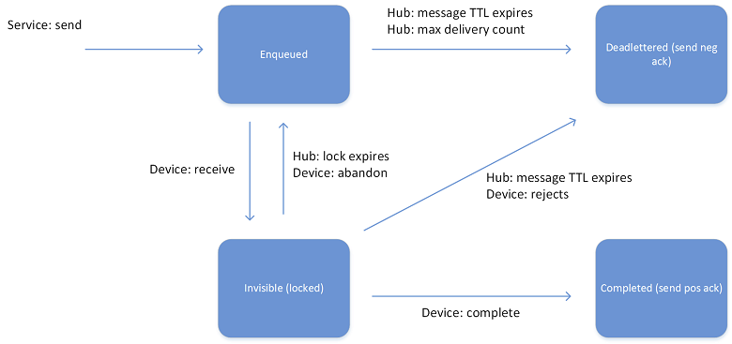
C2D: Messages
Lifecycle
At least once delivery guarantee,
Messages are persisted in per-device queues
Devices must explicitly acknowledge completion for message to be removed
This guarantees resiliency against connectivity and device failures.
Feedback
The service can request the delivery of per-message feedback regarding the final state of that message.
Notes:
MESSAGE LIFECYCLE
In order to implement at least once delivery guarantee, cloud-to-device messages are persisted in per-device queues, and devices must explicitly acknowledge completion in order for IoT Hub to remove them from the queue. This guarantees resiliency against connectivity and device failures.
When the service sends a message, it is considered Enqueued. When a device wants to receive a message, IoT Hub locks the message (sets the state to Invisible) in order to allow other threads on the same device to start receiving other messages. When a device thread completes the processing of a device, it notifies IoT Hub by completing the message.
A device can also:
Reject the message, which causes IoT Hub to set it to the Deadlettered state.
Abandon the message which causes IoT Hub to put the message back in the queue with the state set to Enqueued.
FEEDBACK
When you send a cloud-to-device message, the service can request the delivery of per-message feedback regarding the final state of that message.
If you set the Ack property to positive, IoT Hub generates a feedback message if and only if the cloud-to-device message reached the Completed state.
If you set the Ack property to negative, IoT Hub generates a feedback message if and only if the cloud-to-device message reaches the Deadletterd state.
If you set the Ack property to full, IoT Hub generates a feedback message in either case.
Important. The service must specify a MessageId for the cloud-to-device message in order to be able to correlate its feedback with the original message.

Slide 31
D2C Azure IoT message routing
Device
IoT Hub
D2C receive endpoint
✉
SB namespace
Routing rules
Queue
Queue Connector
✉
✉
✉
Queue
EH namespace
Event Hub Connector
✉
✉
EH
EH
Notes:
Before we added IoTHub message routing, IoT Hub was exposing only one endpoint for telemetry, if you remember from previous slide, it was Receive device-to-cloud events.
We’ve introduced message routing for obvious reasons like:
In order for IoT Hub to routing messages to other endpoints, the service has to know about the other resources. Here, the IoT hub knows about two queues and two event hubs in the user’s subscription.
<click>
When the device sends a message, IoT hub runs user-defined routing rules on the properties to figure out which endpoints to send the message to. A message may be sent to as many endpoints as rules it matches.
<click>
Once the rule processing is complete, IoT hub dispatches the message to the endpoints. IH has connectors for each Azure resource associated with it.
<click>
The message is ready to be processed by the downstream applications reading from each endpoint.Event Hubs
Service Bus queues
Service Bus topics
We are currently implementing routes to more Azure services, like for example storage

Slide 32
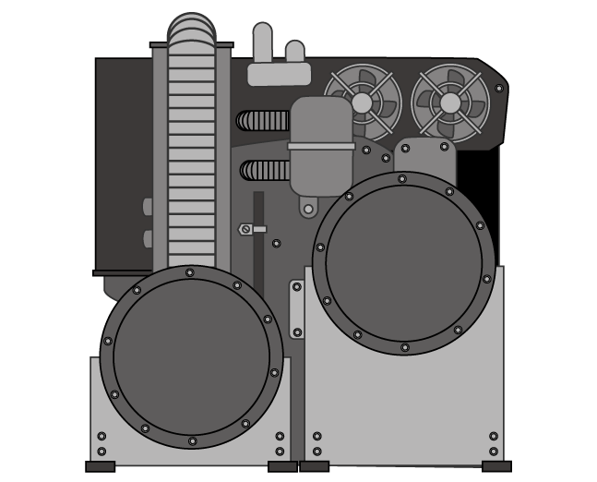
D2C: Consuming events
Code against SB msg API
Interactive path
Easy event processor implementation
Enable deduplication on Q
Easy routing to different subcomponents
Create SB Q/T based on expected throughput
Service Bus Q/T
Workers
IoT Hub
Use any event processor
Hot path
Easy to select only “real-time” data.
Storm / Spark
Custom code
Azure Stream Analytics
Router
Cleaning, normalization, logging
Analytics
Cold path
Run batches from blob
Reuse existing batch code
Easy with Azure Data Factory
Blob
C&N&L
Analytics
Notes:
There are several suitable patterns for consuming events.
Your choice will be driven by a number of factors:
Frequency of messages.
Time to response required.
How important it is to maintain a history of messages.
There might be situations where you need to process a large batch of data from the field.
For example, taking several months of historical data and using it to train a machine learning model.
This is easy in the Azure IoT Suite because we push all the telemetry data out to blob storage, we can pick it up with Azure Data Factory and move it across a machine learning model.
There might be situations where you need to process a large batch of data from the field.
For example, taking several months of historical data and using it to train a machine learning model.
This is easy in the Azure IoT Suite because we push all the telemetry data out to blob storage, we can pick it up with Azure Data Factory and move it across a machine learning model.

Slide 33
D2C: IoT Hub OSS connectors:
IoT Hub
Kafka Connect IoT Hub
IoTHub2Cassandra
IoTHubReact
(OSS Connectors)
Kafka
Cassandra
Spark
New OS Services
https://github.com/Azure/toketi-kafka-connect-iothub
https://github.com/azure/toketi-iothubreact
Notes:
Connectivity to open source software is very important for Microsoft, this is why we’ve built these OSS connectors from IoT Hub to many open sources services, like Kafka, Spark, Cassandra for Java and Scala interfaces and we continue to invest in them.
All of them are open source
IoTHubReact
Open source github.com/azure/toketi-iothubreact
Stream library for IoTHub which read telemetry data and create streams to, for instance Spark or Kafka and support checkpoint using various storage facilities (Azure blob, Cassandra, ..)
We are enabling now command and control to Send Cloud to Device messages via IoTHub
Kafka Connect IoT Hub
Publish events to a Kafka topic so devices telemetry data can be consumed by backend services connected to kafka
Supports Parallel processing to get data from different partitions
IoTHub2Cassandra
Connector based on IoTHubReact to send telemetry data from IoTHub to Cassandra
Table schemas can be defined via JSON
Can store data on one or more tables
Exposes REST APIs

Slide 34
Devices & Gateway SDK
12:00 - Lunch

Slide 35
SDK Library
SDK, agent libraries
Easily accessible libraries in GitHub
Cross platform support
Choose real time OS, platform and language
Device support
IP and access control capabilities
Connect IP, and non-IP devices
Support for direct connection devices and resource strained or non-IP devices via gateway and field protocols
Open source framework
Develop custom agents for your devices
Secure communication
Simple and secure D2C and C2D connectivity for messaging, device management and command and control
OS support
RTOS, Linux, Windows, Android, iOS etc.
Dev tool support & samples
IoTHub-explorer, Device Explorer, iothub-diagnostics
13:00
Notes:
We offer open source device SDKs and service SDKs hosted in github. Device SDKs enable you connect client devices to Azure IoT Hub. Service SDKs help you to build applications that interact with your devices, send desired properties to your devices, call direct methods, job management and manage device identities in your IoT hub
We offer a broad range of OS platforms and devices, from microcontrollers (ARM mbed), RTOS, Linux, Windows, but also Android and iOS via Xamarin
Th languages supported are: C, C#, JS, Java and Python
We require the device to be capable of establishing an IP connection and TLS/SSL capable: only IP-capable devices can communicate directly with Azure IoT Hub, however we can connect IP, and non-IP devices via gateway and field protocols
+ many dev tools support & samples

Slide 36
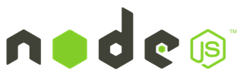

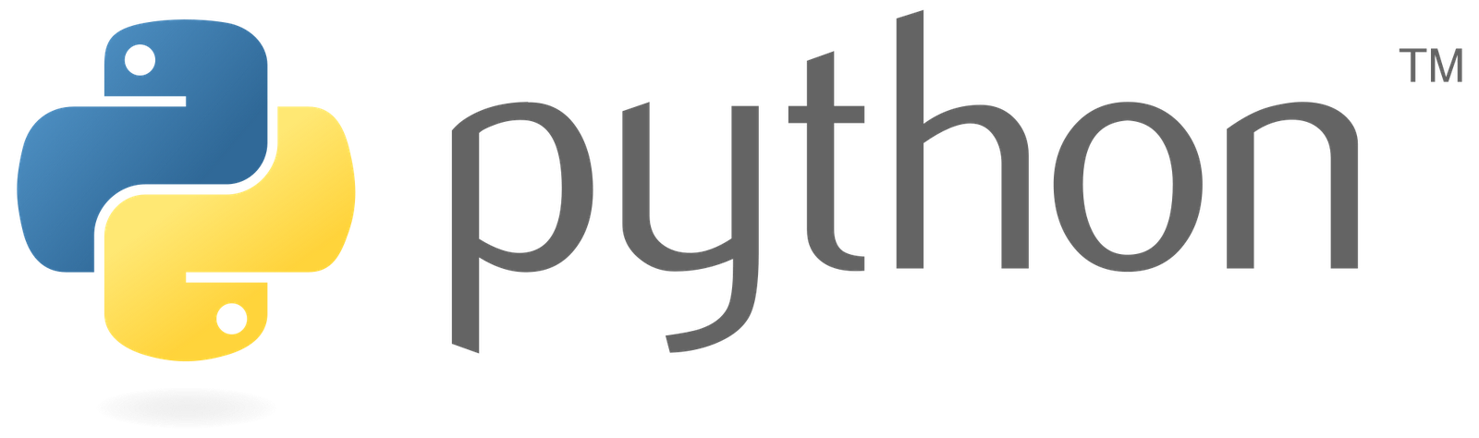
Service SDKs support
.NET
Node.js library:
Node.js (v 0.10+)
Java library:
Java (v 1.7+)
C# libraries supported:
Windows Desktop (7,8,10)
Universal Windows Platform
Python library:
v 2.7.x
v 3.5.x
Notes:
Note: managed agent code requires .NET framework 4.5

Slide 37
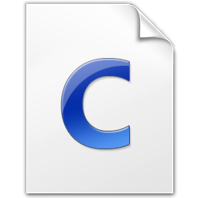
Device SDKs support
C library:
Microcontrollers
RTOS
Linux
Windows
Node.js library:
Node.js (v 0.10+)
Node-RED
Java library:
Java (v 1.7+)
Android
.NET
Android (Java or Xamarin)
Arduino
Debian Linux (v 7.5)
ESP8266
Fedora Linux (v 20)
FreeRTOS
iOS (Xamarin)
mbed OS (v 2.0)
OpenWRT
Raspbian Linux (v 3.18)
C# libraries supported:
Windows Desktop (7,8,10)
Universal Windows Platform
Windows 10 IoT Core
Xamarin (iOS, Android)
Python library:
v 2.7.x
v 3.5.x
STM32
TI RTOS
Ubilinux (v3.0)
Ubuntu Linux (v 14.04)
Windows Desktop (7, 8, 10)
Windows IoT Core (v 10)
Windows Server (v 2012 R2)
Yocto Linux (v 2.1)
… more @ Azure Certified for IoT device catalog.
Notes:
On device platform we have minimum requirements which support
Being capable of establishing an IP connection: only IP-capable devices can communicate directly with Azure IoT Hub.
Support TLS: required to establish a secure communication channel with Azure IoT Hub.
Support SHA-256: necessary to generate the secure token for authenticating the device with the service.
Have a Real Time Clock or implement code to connect to an NTP server: necessary for both establishing the TLS connection and generating the secure token for authentication.
Having at least 64KB of RAM: the memory footprint of the SDK depends on the SDK and protocol used as well as the platform targeted. The smallest footprint is achieved using the C SDK targeting microcontrollers.
We have a broad range of language support and you could see them listed here

Slide 38
IoT Hub Developers tools
IoTHub-explorer: node based CLI
npm install -g iothub-explorer
Device Explorer: Windows centennial app
Installer in releases of github.com/azure/azure-iot-sdks
New X-Plat UI tool coming soon
Coming soon!
Device discovery CLI
npm install -g device-discovery-cli
IoTHub Diagnostics tool
github.com/azure/iothub-diagnostics
IoT Developer Center Samples
Azure.com/iotdev
Notes:
We have created many developer tools to help you to manage your devices
IoTHub explorer-A CLI tool to manage device identities in your IoT hub registry, send and receive messages and files from your devices, and monitor your IoT hub operations.
Device Explorer – similar but offering User Interface
Diagnostics tool to help you diagnose issues with a device connecting to Azure IoT Hubs.

Slide 39
Azure IoT Gateway scenario and benefits
End user IoT gateway scenarios
Benefits
Security and isolation of devices
Bridge networks and isolate public Internet
Ensure cloud security and encryption
Integration with any device
Low resource devices
Device agents can be simplified
Connect new and legacy devices
Cloud offload
Run logic on premises to reduce network & cloud consumption
Low-latency / critical messages
Segregate message types
Edge processing
Enable time-sensitive decisions
Run edge analytics
Auditing - Central choke point to apply data policies
Batching
Optimize bandwidth and messages
SI & end user – Reduced time to market and maintenance costs for gateway solutions
OEM - Increased margins on gateway hardware compared to IoT Devices
ISV - Monetize modules built on top of Azure IoT Gateway SDK
Notes:
With our SDKs we facilitate the creation of on-premises gateways that allow your IoT solution to do more:
connect purpose-built and legacy devices without replacing existing infrastructure
run logic on premises to reduce network and cloud consumption
run analytics on the edge, perform time-sensitive decisions by minimizing latency, and enforce security and privacy constraints.
There are many benefits for other parties, like for example for ISV, they can create and monetize modules built on top o Azure IoT Gateway SDK

Slide 40
Azure IoT Gateway SDK architecture
https://github.com/Azure/azure-iot-gateway-sdk/
On-prem gateway
IoT Hub
Local file
Custom Module
Custom Module
Custom Module
Custom Module
Module
Protocol X
Ingestion
Filter
Identity Mapping
Logger
IoT Hub
Send to cloud
HTTPS
MQTT
AMQP
Message 1
Message 1
Message 2
Message 2
Message 3
Message 1, 2, 3
Message 3
Protocol X
Telemetry
Properties
Properties
Properties
Properties
Properties
Properties
Content
Content
Content
Content
Content
Content
Message Broker
BLE (Bluetooth Low Energy) Module
Logger Module
Identity Map Module
IoT Hub Module
OPC-UA
Modbus
Simulated Device Module
Hello World Module
…and many more to come
Notes:
Open Source
Cross platform: Windows or Linux
Runs on many types of hardware
Standards based (written in ANSI C C99)
Azure IoT Gateway SDK architecture consists of chain of modules seen as data pipeline, these modules are pluggable and configurable
Message Broker facilitates the communication of the modules
Modules are passing each other messages. They publish messages to the broker (like in a pub/sub) and then let the broker route the message to the modules which subscribed to the source module
we offer out of the box modules which perform common gateway functions (example: BLE module supporting a low energy device ingestion, Logger which helps log all the telemetry data ingestion locally on the device, IoTHub which function is to communicate to IoTHub via our standard protocols). You could use our modules as they are or customize them or create new modules (translating specific protocol)
Our SDK offers interfaces needed for a developer to write his own custom modules
the infrastructure needed to deploy and run a set of modules
The communication with IoT Hub is bi-directional supports also Cloud to Device Messages, notice the communication is bi-redirectional
In this sample architecture, we have 5 modules which are ingesting the data, filtering it, mapping the physical device unique identity which is MacAddress and mapping it to IoTHub device identity, logging the data and finally send it to IoTHub via any of the supported protocols.
Write modules in C, Java, C#, Node.js. Mix and match!
Modules talk to each other through a message broker
Out-of-the-box modules
Gateway is easy to configure: JSON or direct APIs
IoTHub Module can use HTTP, AMQP, or MQTT transports
Buffers data when the network connection is down, supports retries
Connection multiplexing with IoTHub module, message batching

Slide 41
Division of work
SDK facilitates gateway software creation. It does not provide an out-of-the-box solution for every customer.
Provided by SDK
Partner/Customer work
Pluggable module architecture (SDK infrastructure)
Simplified gateway creation (SDK infrastructure)
Efficient D2C and C2D connectivity (modules)
Protocol translation example (modules)
Configuration of module pipeline
Writing modules for any logic not provided by SDK
Deployment and maintenance of gateway solution to hardware
Notes:
Simplified gateway creation – Developers can use a JSON configuration file to specify which models are attached to the message broker. This is an improvement over declaring, initializing, and connecting all of the modules to the message bus by hand.
Efficient D2C and C2D connectivity – The module which sends and receives data from IoT Hub on behalf of devices makes sure to multiplex these connections over one gateway to IoT Hub connection. In other words, even if there are 100 devices with their own connection to the gateway, the gateway will only create one connection to the cloud and send data all devices over that one connection.
Protocol translation example – The SDK contains an example of how to do protocol translation for a TI Sensor tag which speaks Bluetooth Low Energy.
Configuration of module pipeline – Developers must choose the modules which make up their gateway and configure the modules according to their exact scenario.

Slide 42
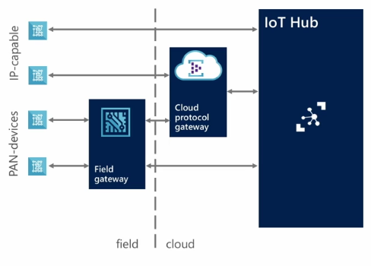
Considerations - Device
Protocols: What protocols are your devices able to communicate with? It needs to be established whether it is supported by the cloud gateway or will require a custom protocol gateway. In addition, what physical networking protocol is it using? Can it support an IP based network?
Platforms: Are your devices compatible with one of the many supported platforms?
Security: Do you require more than server authentication?
Notes:
A wide variety of devices that we may need to work with. Some may be in-place already; i.e. We have an existing device that we need to connect. Others may be greenfields devices; i.e. we are specifying and building the device as part of the solution we’re rolling out.
When thinking about Protocols we need to consider two areas.
What messaging protocol are our devices able to communicate using? One of the IoT Hub supported protocols (AMQP, HTTP and MQTT)? Or does it use a proprietary protocol that we’ll need to broker either in the field or in the cloud?
What physical networking protocol does the device use? Many devices, particularly smaller devices, may be using lightweight PAN networks to communicate (BT/BTLE/Zigbee,6LoWPAN) and will need a device in the field (a field gateway) to connect them to an IP based network and then to the Cloud.
What programming platforms are going to be used? Will you be able to port one of the Azure IoT client SDKs across to your device? Or are we going to have to port the C library across to the platform?
What security requirements are required, in particular, what approach is going to be taken to authentication between device and cloud?

Slide 43
Considerations - Cloud
Telemetry: How will you be monitoring your devices? What outputs do you require for analysing data from the hub?
Device Business Logic: How will your devices process commands and software updates?
Management: Devices being provisioned need to be managed correctly by the hub. How will this be maintained and updated?
Notes:
When considering what will need to be achieved in the cloud:
What are the types and volumes of data to be processed? Some cloud IoT platforms are more capable than others when it comes to high volume telemetry ingestion; indeed some require using two different paths for device command and control vs telemetry ingestion.
How will your device deal with command and control requirements and how will you manage and update devices in the field. Having a suitable mechanism for remote update of devices will be critical in most scenarios; much of the value of low cost IoT devices will be lost if they require a technician to visit them in the field for updates; silicon has gotten much cheaper but technician labor costs have not.

Slide 44
Hands-on Lab 2, then Lab 4
Lab 2: Device Explorer & Custom Device (45 minutes)
Concepts demonstrated:
C# SDK
D2C
C2D
Device Explorer
Lab 4: Updating Device Firmware (45 minutes)
Concepts demonstrated:
Provisioning an Event Hub manually using the Portal
Creating device identity manually using Device Explorer
Node.js SDK
Calling device methods to update firmware
Firmware update loop
13:30 – 15:00

Slide 45
Microsoft Azure IoT Technical Scenario: Analyze streaming data
15:05
Notes:
For a recorded presentation by Azure IoT Program Management through C+E University: IoT Online webinar series: please visit:
https://mspartnerlp.partner.microsoft.com/LearningPath/LearningPath/DLPaths?trackId=2918&rowId=3606&trackPathId=14612

Slide 46
Elements of Azure IoT Suite
Connect and Manage Devices & Gateways
2. Analyze streaming data
3. Integrate into business systems
Preconfigured solutions
Real time analytics
Workflow integration
Gateway & Devices
Data visualization
Push and broadcast notifications
Connect and control
Predictive analytics*
ID and access management
4. Secure IoT Infrastructure
5. Customize IoT Architecture
* Only applies to Predictive Maintenance
Notes:
In this deck we will be focusing on the second of these elements. We have connected our devices and set up a path of data to flow the Azure cloud. Now how do we analyze the data coming in and visualize the results. there are many different services available that are part of the Azure IoT suite that can help. However it is first important to understand the different analysis patterns available

Slide 47
Considerations: Processing & Analysis
Event Processing
Is event-at-a-time logic a suitable processing type?
Raw / Processed Data Retention?
Error processing logic?
Rules
How will you structure thresholds to trigger events?
Will you require window-based aggregates?
How to deal with errors?
Analytics
Are you going to be running batch analytics against data?
Will interactive or real time analytics be required?
Can Machine Learning can be applied to the solution?
Integration
Do you need to integrate existing applications?
Notes:
When you think about designing and architecting your IoT solution, here are some additional considerations (more will be discussed in the hands-on labs).
Event Processing
Is synchronous event processing sufficient? Or will you need to run an aggregate event processing pipeline?
This will effect your approach to Rules.
How’re you going to represent your rules?
…
The Azure IoT Suite uses Azure Stream Analytics which supports this rich rule and event based processing.

Slide 48


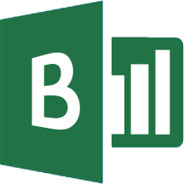
Azure IoT analytics patterns
Device
Collection
Ingestion
Stream Analysis
Storage &
Batch Analysis
Presentation & Action
IoT Hub
Stream Analytics
Storage Blobs / Tools
Web/thick client dashboards
Device Twin
SQL DB /SQL DW
Machine
Learning
Gateway
Document DB
Devices
RTOS, Linux, Windows, Android, iOS
Event Hub
Search and query
Ingest
Filter
Send
Routing
Service Bus
Data Lake
Data analytics (Power BI)
Apache Storm/Spark
Casandra DB
Device Twin
Devices to take action
On-Device App Analytics
On-Gateway Analytics
In-Cloud
Analytics
In-Cloud
Hot-Analytics
In-Cloud
Cold-Analytics
In-Cloud
Analytics
Notes:
IoT supports multiple patterns of analytics as you can see. For simplicity’s sake lets look at each phase in an IoT solution where analytics can be applied.
Let’s start with the one on the left. The first is on the edge where you can add modules to filter, aggregate, log, route data and more. This phase is prevalent in many gateway scenarios.
Even during In-Cloud Ingestion-Analytics can be supported. Such as querying the twin within Azure IoT Hub, filtering and routing message at this level etc.
There are two main patterns that can be applied to the data for IoT.
The first one is hot path: Where data is actually analyzed in real time. In this path real time event monitoring whether simple or complex becomes critical. The incoming data is analyzed based on a set of rules and the data can then be transformed and insights generated. Typically looking at this data through the time series lens can make it even more important to generate accurate predictions. This data can also be applied to machine learning models to better produce the desired output or prediction. There are many different services that can support hot path analytics some of which we will discuss today.
Another path we see is the cold path where data is moved into some sort of storage and then different analytic services dependent on your needs can be used to generate insights.

Slide 49

Batch Analytics (Cold Path)
DATA SOURCES
INGEST
PREPARE
ANALYZE
PUBLISH
CONSUME
On-Prem Storage
Orchestration, Movement, Scheduling, Monitoring
Ex: Azure Data Factory, Oozie
Ex: SQL Server, Oracle, DB2, MySQL
Batch Data Movement
Transform, Combine, Clean, etc.
Data Aggregation, Data Science, etc.
Ex: Azure Data Lake Analytics, Hadoop, Azure Machine Learning, Mahout
Presentation, Dashboarding
SaaS Data Sources
Ex: SSIS, Azure Data Factory, Sqoop, IoT Hub (via File Upload)
Ex: Custom Code, Azure Data Lake Analytics, Hadoop
Ex: SQL Server, Oracle, DB2, MySQL
Ex: File Upload via IoTHub)
Cloud Storage
Ex: Azure Data Lake, Azure SQL DB, Azure SQL DW, HDFS, Cassandra, HBase
IoT Hub
Notes:
Traditional analytics first moves data (Archived, historical, logs, etc) into some sort of storage and then different analysis is applied to it to generate insights. This is still a common pattern that we must at least talk about briefly as many non software companies still understand this scenario better. Plus when you talk about kicking off POC’s it is very simple to start with making sense of historical data first.
As you can see Azure IoT Hub can push cold data directly into blob using file upload feature, or telemetry data using Event Hubs can be pushed into different storage types whether it is Blob or Data Lake or something else. Then machine learning can be applied to this data after it has been cleaned, prepped and transformed. Azure IoT suite and Cortana Intelligent suite components can be leveraged here and finally the insights from this data can be visualized, fed back into business systems or actions back on devices can be taken as well.

Slide 50
Near Real Time Analytics (Hot Path)
DATA SOURCES
INGEST
PREPARE
ANALYZE
PUBLISH
CONSUME
Stream Processing
Scalable device
data ingestion
Ex: Azure Stream Analytics, Storm, Spark
Ex: Azure IoT Hubs, Kafka, Kinesis
Devices
Machine Learning
Archival
Presentation, Dashboarding
Ex: Azure Machine Learning, Mahout
Storage
Ex: Azure Data Lake, Azure SQL DB, Azure SQL DW, HDFS, Cassandra, HBase
Orchestration, Movement, Scheduling, Monitoring
Ex: Azure Data Factory, Azure Function, Oozie
Notes:
Hot path or real time analytics or streaming analytics is becoming extremely popular due to its usefulness in IoT scenarios.
Real time analytics refer to analyzing fast moving data streams and events, while the data is still on the wire. As seen in the previous slide, In traditional data analytics you first store the data in a database and then run analytics on the data to uncover insights. But, you do not always have the luxury of time to do that – as many insights have a very short shelf life for you to act on. For example, you have less than 5 seconds to stop an overheated engine , detect a power failure, detect a fire in a building – so that you can promptly address such situations and avoid catastrophic damage.
This real time analysis when coupled with machine learning and visualization is gaining a whole lot of momentum in the IoT space. This combination of analytics on data on the wire can lead us from proactive monitoring to predictive and prescriptive analytics.
The data through real time analysis can be fed through machine learning which will determine the probability of predicting a certain outcome based on the algorithm and historical data. This outcome can then be visualized graphically and a predictive action can be taken saving millions of dollars in efficiency and giving way to new business models.

Slide 51
Analytics with IoT Suite preconfigured solutions
Azure IoT Suite Remote Monitoring and Predictive Maintenance*
Devices
Back end systems and processes
Power BI
Web/ Mobile App
Storage blobs
DocumentDB
C# simulator
IoT Hub
Stream Analytics
Event Hub
Web Jobs
Logic Apps
* Azure ML
* Machine Learning available with Predictive Maintenance only
Notes:
This pattern of analytics is the back bone of the Azure IoT reference architecture and is used in our Remote Monitoring and Predictive Maintenance architectural frameworks for PCS. As you can see in this implementation we are using many different analytics services, and will dig deep into the services outlined in red which make the analytics patterns discussed above possible.
First we Provision simulated devices with a C# device emulator running .Net. These simulated devices are connected to a IoT Hub that manages the two way communication between cloud and device and creates a secure command and control channel.
Event Hub is queried by a web job running an event processor host to determine where and alarm or alert needs to be pushed – such as sending an alert to dashboard for a human operator to take action.
Logic Apps are used to create more complex work loads and integrate into line of business and other proprietary applications.
Document DB stores all the metadata and device properties for each connected device.
Blobs store telemetry information and telemetry data. Other tools such as Azure Machine Learning and PowerBI can access this information for data visualization or processing advanced analytics.
Webapp – Dashboard code is available in Github allowing it to be fully customized by the user to align with a scenario or be relevant for an enterprise application.
Azure Active Directory controls user ID’s and access, allowing the service to be shared with relevant decision makers within the business but restrict access to certain controls or devices.
PowerBI is used for both open-source embedded components within the dashboard and also for complex external analytics of trends and patterns across all stored data.

Slide 52
Real time analytics Azure Stream Analytics
Learn more at: https://docs.microsoft.com/en-us/azure/stream-analytics/
15:45
Notes:
So now let’s take an in-depth look at some of these services that makes these analytic patterns possible. The first one we will look at is the Azure Stream analytics.

Slide 53




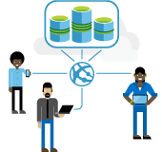
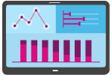

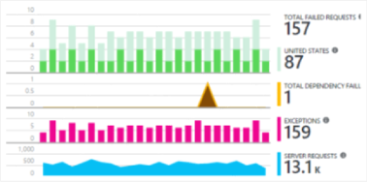
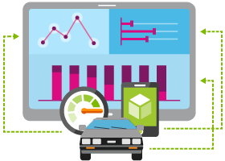

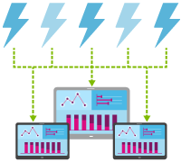
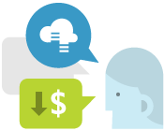
Scenario examples
Real-time Fraud Detection | Streaming ETL | Predictive Maintenance | Call Center Analytics
IT Infrastructure and Network Monitoring | Customer Behavior Prediction | Log Analytics | Real-time Cross Sell Offers
Fleet monitoring and Connected Cars | Real-time Patient Monitoring | Smart Grid | Real-time Marketing
and many more…
Notes:
As you can see there are many scenarios where stream analytics is applicable. From a practical perspective a lot of the stream analytics is looking at telemetry data in real time and getting insights whether this is looking at credit card data from Point of Sale devices or looking at data in real time from a truck for fleet management for route optimization to making real time power related decisions based on data from power grids. Real time analytics is becoming key in IoT scenarios where the telemetry data streaming from the devices need to be acted upon in a very short time frame for a big impact on corporations. The example is credit card transactions from Point of Sales and data analysis from Power Grids to determine anomalies for appropriate actions.
Azure Stream Analytics makes all of it possible!!

Slide 54
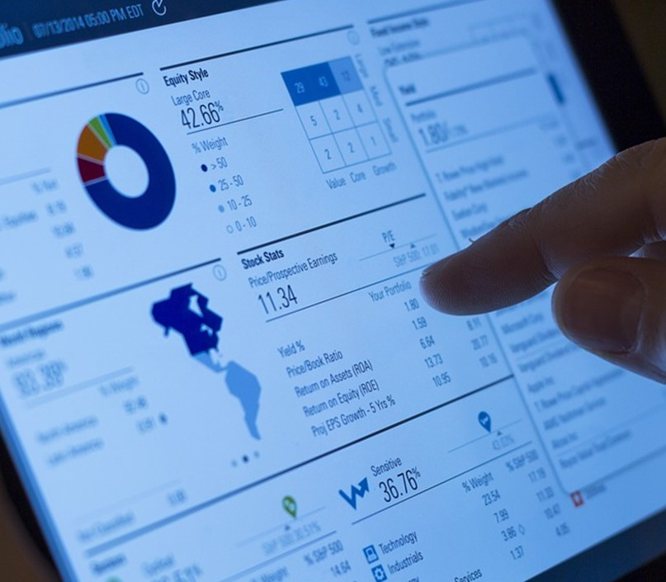
Azure Stream Analytics
Uncover insights in real time
Perform low latency analytics across multiple data streams.
Rapid development
Use simple SQL syntax to develop and deploy powerful analytics.
Extensive out of the box integrations
Ready integration with Blob Storage, ML, Power BI, Service Bus, etc.
Fully managed
No maintenance. No performance tuning. Zero upfront costs.
Enterprise grade
Guaranteed event delivery, auto recovery and 3x9s availability.
Hyperscale
Distributed architecture can analyze millions of events a second.
Notes:
Like we discussed in the previous slides, Azure Stream Analytics helps monitor your IoT infrastructure, detect anomalies and respond back to critical situations in real time. This is achieved by means of continuously analyzing single or multiple streams of data, identify complex correlations among these streams of data and flagging discrepancies or pre defined patterns as they occur for further actions.
Azure stream analytics is very developer friendly . One could easily write streaming queries just like a SQL query. Some of the other similar technologies out there need developers to express logic in Java or C#, which results in longer developer ramp-up time and a lot more IT budgets to pay for such skills.
Azure Stream Analytics has strong integration with a wide array of services on Azure. Whether it is reading reference data from Azure blob storage, or scoring events in real time with Azure ML algorithms, or writing results to a Power BI real time dashboard – we have you covered. Such out of box integrations help customers rapidly build new applications.
Azure Stream Analytics is a fully managed PaaS service in Azure. There are no upfront costs involved in setting up compute clusters and complex hardware wiring like you would do with an on-prem solution. You only pay for what you use. Also, you as a customer will never have to do any performance tuning. We take care of all of it in the background.
Azure Stream Analytics is Enterprise grade. It is compliant with many industry and government certifications such as SOC, HIPPA, ISO etc. That’s how customers are able to scale up their businesses confidently. Azure stream analytics promises 3 9s availability that is financially guaranteed.
Then, there is built in auto recovery so that customers will never lose the data. And the good thing is – you do not need to write a single line of code to achieve this. Azure Stream Analytics is available across multiple worldwide datacenters and sovereign clouds .
Azure Stream Analytics is a highly scalable solution that can process millions of events per second and produce results with a sub second latencies. We talked about variable workloads . With Azure Stream Analytics you do not need to design your system for peak throughputs and can add more compute footprint as you go.

Slide 55

Streaming pipeline
Data Lake, Document DB, SQL DB/DW, …
Archiving for long term storage/ batch analytics
Applications
Event Hubs
Stream Analytics
Devices &
Gateways
PowerBI
IoT Hubs
Real-time dashboard
Service Bus Topics/Queues -> Worker Role …
Blobs
Automation to
kick-off workflows
Machine Learning
Reference Data
Event production
Event Queuing & Stream
Ingestion
Stream Analytics
Storage &
Batch Analysis
Presentation & Action
Notes:
Now lets take a deeper look at Azure Stream analytics and how it can be used in your IoT solutions. ASA’s streaming pipe is set up as jobs which have a set of inputs, outputs and queries associated with it. Both IoT Hub and Event Hubs can stream data directly into ASA. In addition you can add a number of reference data streams for richer processing. The output of the jobs can be any data storage like blob or SQL or Event Hubs or Service Bus Topics so the insights can be integrated into other business processes like Dynamics CRM etc or simply be routed to Power BI for visualization.
Available Outputs:
SQL Database
Blob Storage
Event Hub
Power BI
Table Storage
Service Bus Queues and Topics
Document DB
Data Lake Store
Data stream inputs
Event Hub: Feed events into Azure in real time, and Stream Analytics jobs can process them
IoT Hub: Stream information collected from connected devices directly into a streaming analytics job
Blob Storage: Can be used as an input source for ingesting bulk data
Reference Data
Static or slow changing used for performing look-ups
Azure Blob Storage is the only supported reference input
Source blobs limited to 50MB in size
Input Data Types
CSV, JSON and Avro Serialized

Slide 56
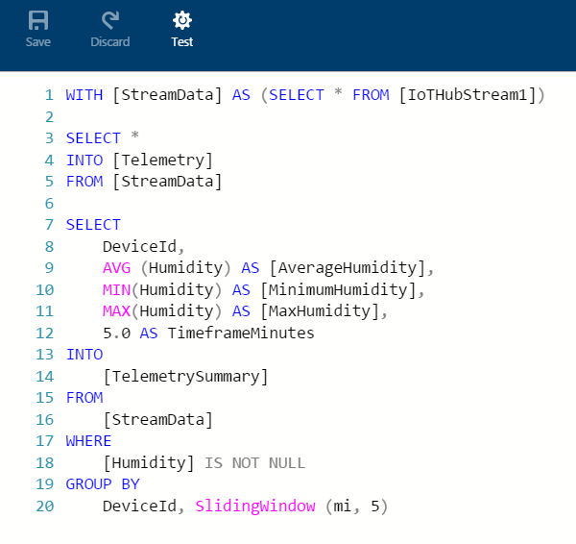
Write powerful analytics using SQL like language
Advanced job monitoring
Rich visual tooling to debug queries and monitor jobs.
Real time data enrichment
Easily join and score streaming data with static reference data or function call-outs.
Out of order and late arrival policies
Account for lag among gateways or sensors through simple configurations and settings.
Windowing
Tumbling, Hopping, Sliding
Custom JS & geospatial functions
Move beyond SQL
ML Integration
Push your data stream through ML webservices
SQL-LIKE Language (subset of T-SQL)
With .NET datatypes
Notes:
Azure Stream Analytics provides you a rich set of visual tools to debug your query as well as monitor your job performance statistics in real time.
The concept of reference data and enrichment is very important to learn about. We always want to shrink payload down because you are transporting data over network, GPRS etc. and only send data that is very relevant. Payload might only look like sensor A, temp x. But, you need to know where this sensor maps to – in other words, where this located, which manufacturer did we get it from etc – in case it fails., So this is called reference data. This is data at rest. We let you add reference data. You can treat reference data as another stream to further augment your streaming data. By the way, this is one of the more used features. You can refresh the blob too. Similarly, you can also use Machine Learning algorithms to score every event as they come in.
Let me talk about Event processing semantics. These concepts that we support through simple configuration settings are really helpful to differentiate ourselves. Through late arrival and out of order policies, we can specify that the system should wait for a certain period of time to ensure all the data comes into IOT hub before I start processing. Maybe some events are coming in from TCP IP connections, some via Bluetooth and so on. This is important where sequence of events is key for your analysis. Basically on our configuration settings, I can say how long I want to wait for the events to.

Slide 57
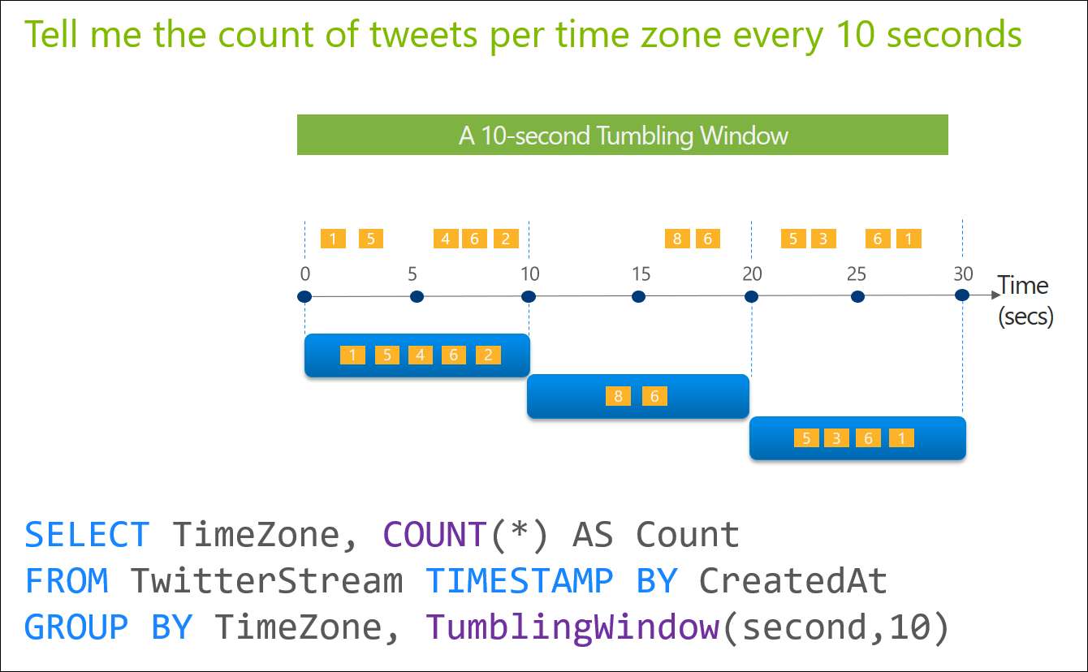
ASA – Tumbling Window
Notes:
Tumbling window functions are used to segment a data stream into distinct time segments and perform a function against them, such as the example below. The key differentiators of a Tumbling window are that they repeat, do not overlap and an event cannot belong to more than one tumbling window.

Slide 58
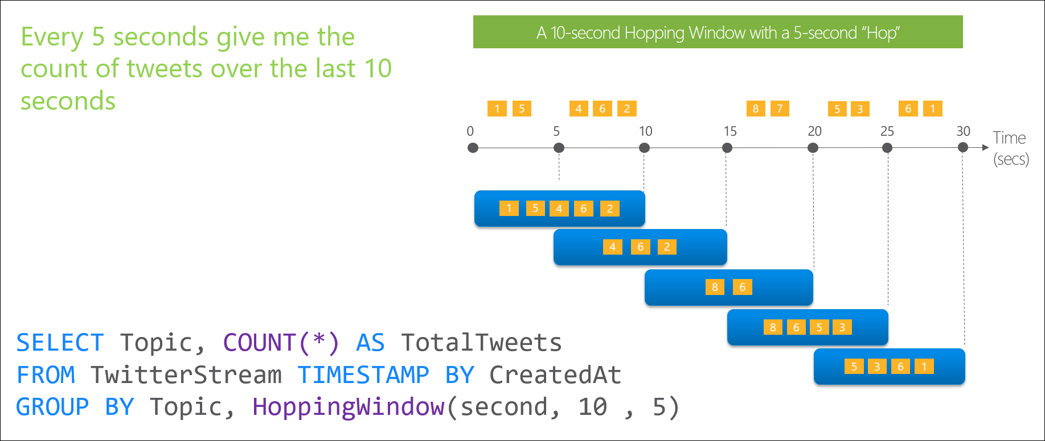
ASA – Hopping Window
Notes:
Hopping window functions hop forward in time by a fixed period. It may be easy to think of them as Tumbling windows that can overlap, so events can belong to more than one Hopping window result set. To make a Hopping window the same as a Tumbling window one would simply specify the hop size to be the same as the window size.

Slide 59
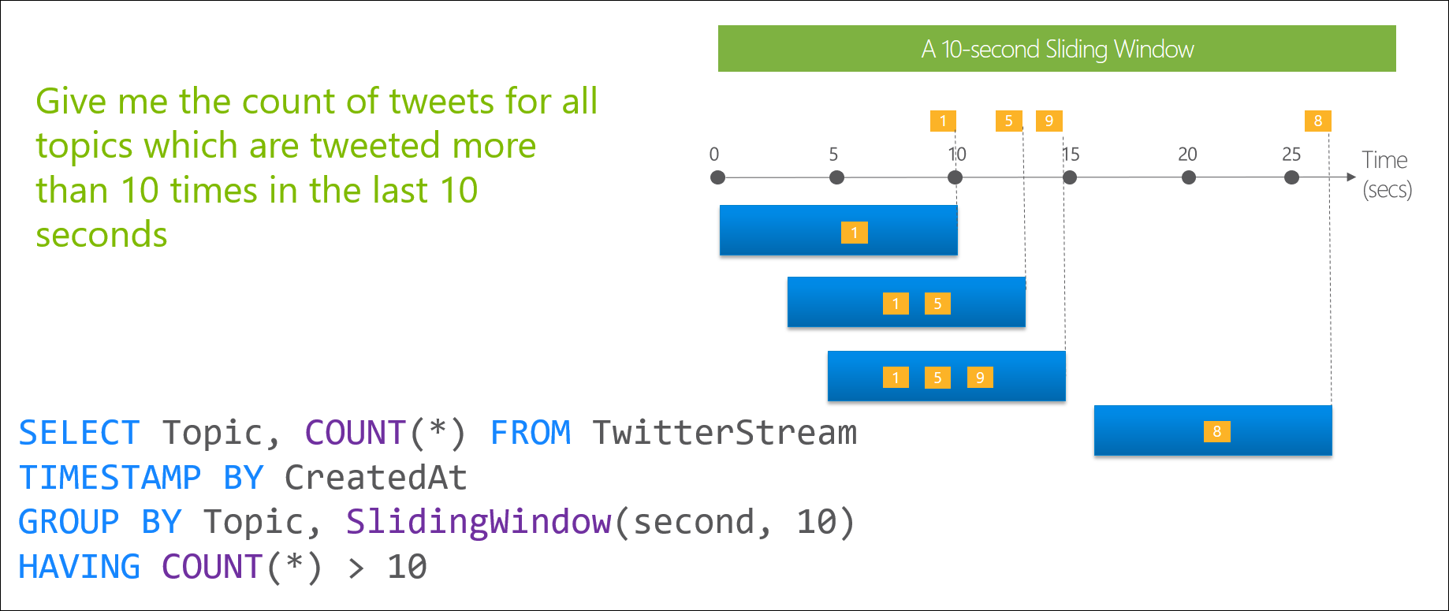
ASA – Sliding Window
Notes:
Sliding window functions, unlike Tumbling or Hopping windows, produce an output only when an event occurs. Every window will have at least one event and the window continuously moves forward by an € (epsilon). Like Hopping Windows, events can belong to more than one Sliding Window.

Slide 60
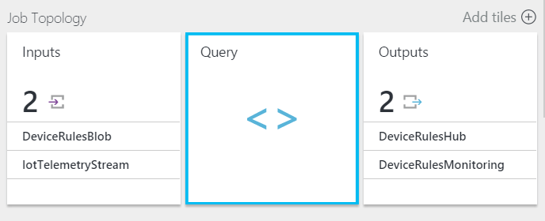
ASA – Remote Monitoring Solution
Remote Monitoring Solution – Three ASA Jobs
1. Route all telemetry to Blob Storage
Saves all stream data that is used to create telemetry chart
2. Route Command Response and Device Status messages
Identifies and routes Command Response and Device Status messages to an EventHub for further processing
3. Rules
Queries telemetry stream against rules
E.g. Uses 5 minute sliding window to get min/max/average of humidity
Notes:
In context of the Azure IoT Remote Monitoring solution

Slide 61
Data Visualization Power BI
Learn more at: https://docs.microsoft.com/en-us/azure/power-bi-embedded/
16:00
Notes:
Power BI is a powerful Data Visualization tool
Power BI addresses three common business intelligence challenges that an organization may face:
1. Getting an end-to-end view off what is happening — because data is often in disparate locations, it can be difficult for business users to see a complete picture of your business
2. Managing multiple data sources — Data residing in SaaS solutions and other external locations can be difficult to manage programmatically, or access and refresh securely
3. Making the right data available to the right users at the right time
Mobile business users need the latest operational data at their fingertips, no matter where they are or what device they’re using
Different roles have different needs and access levels, so a one-size-fits all solution doesn’t work

Slide 62
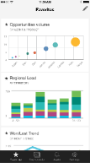
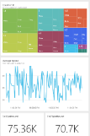
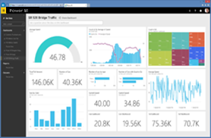
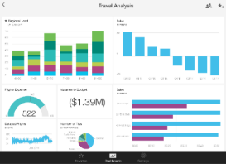
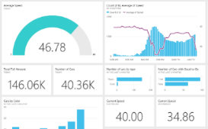
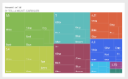
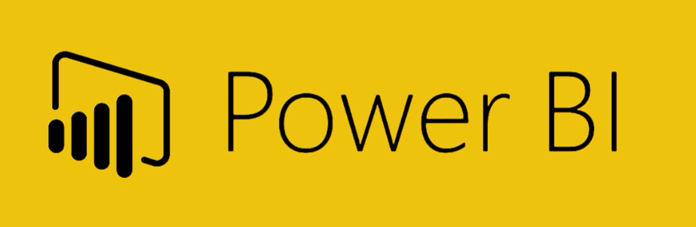
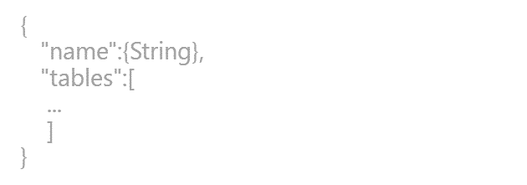
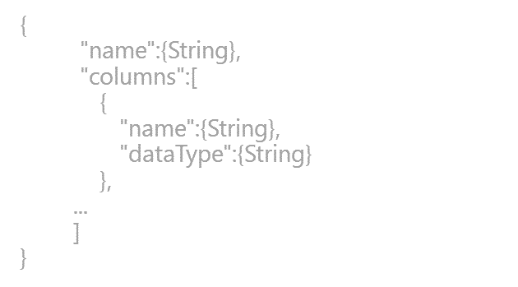
Power BI overview
SaaS solutions
E.g. Marketo, Salesforce, GitHub, Google analytics
Content packs
Natural language query
Sharing & collaboration
On-premises data
E.g. Analysis Services
Live dashboards
Organizational content packs Corporate data sources, or external data services
Visualizations
Azure services
E.g. Azure SQL, Stream Analytics
Excel files
Workbook data and data models
Reports
01001
10101
Power BI Desktop files
Related data from files, databases, Azure, and other sources
Datasets
0110001
00010110
Data refresh
Power BI Desktop
Power BI REST API
Prepare
Explore
Report
Share
Notes:
Let’s walk through an overview of how Power BI works.
1. The Power BI service, sometimes referred to as powerbi.com, is what allows you to:
Create beautiful visualizations to tell compelling data stories
Build rich, live dashboards that turn BI into business insights
Create reports & datasets from which you can create visualizations and dashboards
Enjoy the benefits of up-to-date data with real-time, automatic and scheduled refreshes
Share dashboards easily with other people in your organization
Ask questions of data in plain English with Natural Language Query
Stay connected to your data all the time with mobile applications
2. Power BI connects to a variety of data sources. These range across both cloud and on-premises sources, and include:
A variety of popular SaaS solutions, such as Marketo, Salesforce, GitHub, Dynamics CRM, Zendesk, and several others
On-premises databases – Power BI offers live connectivity to SQL Server Analysis Services, which we’ll cover in more detail later. And using a gateway solution, Power BI can connect to other database solutions.
Custom data sources – Power BI can connect to any data source you need it to thanks to its extensibility via REST APIs. This includes both proprietary corporate data sources, as well as external data services. For example, if you are a SaaS solution provider, you can work with Microsoft to connect your solution to Power BI.
Other Azure services – Power BI integrates tightly with SQL Azure and Stream Analytics, and will be integrating closely with more Azure services over time
Power BI Desktop and Excel files – Excel workbooks can be directly connected to Power BI.com, or may be used with Power BI Desktop. Power BI Desktop is a companion application to the Power BI service – it is a desktop tool that supports data analysis and reporting. Like Excel files, Power BI Desktop files may be uploaded to the Power BI service.

Slide 63
Hands-on Lab 3
Lab 3: Processing Telemetry Data (45 minutes)
Concepts demonstrated:
C# SDK
D2C
C2D
Extending device capabilities
Power BI
Azure Stream Analytics
16:05

Slide 64

A quick note on Event Hubs
Notes:
PowerBI is a powerful Data Visualization tool
Power BI addresses three common business intelligence challenges that an organization may face:
1. Getting an end-to-end view off what is happening — because data is often in disparate locations, it can be difficult for business users to see a complete picture of your business
2. Managing multiple data sources — Data residing in SaaS solutions and other external locations can be difficult to manage programmatically, or access and refresh securely
3. Making the right data available to the right users at the right time
Mobile business users need the latest operational data at their fingertips, no matter where they are or what device they’re using
Different roles have different needs and access levels, so a one-size-fits all solution doesn’t work

Slide 65
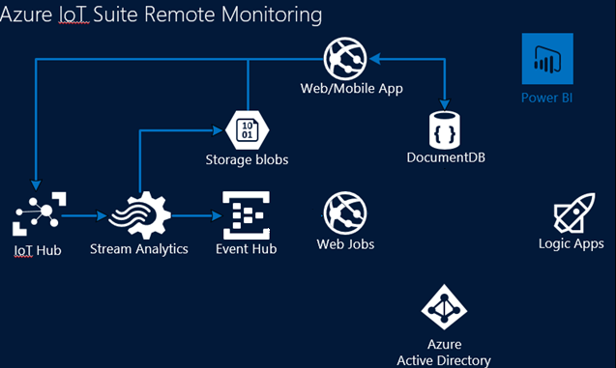
Device Event Processor
Remote monitoring solution
Device Event Processor
Feeds events into Web/Mobile apps
Feeds into logic apps
Device schema updates into DocDB
Located in EventProcessor.WebJob in source
Notes:
In terms of the usage of Event Hubs within the Azure IoT Suite Remote Monitoring Preconfigured solution:
- Azure Stream Analytics feeds certain events into Event Hubs to then be passed through via Web Jobs into both the Portal and logic apps.

Slide 66
IeventProcessor Class
IEventProcessor
Event Processor Host
Azure Event Hub
Direct
Receivers
> 1M Producers > 1GB/sec Aggregate Throughput
Consumer Group(s)
Partitions
Event Producers
PartitionKey
Hash
AMQP 1.0
Credit-based flow control
Client-side cursors
Offset by Id or Timestamp
Throughput Units:
1 ≤ TUs ≤ Partition Count
TU: 1 MB/s writes, 2 MB/s reads
Up to 32 partitions via portal, more on request

Slide 67

Predictive analytics Azure Machine Learning
Learn more at: https://azure.microsoft.com/en-au/services/machine-learning/

Slide 68
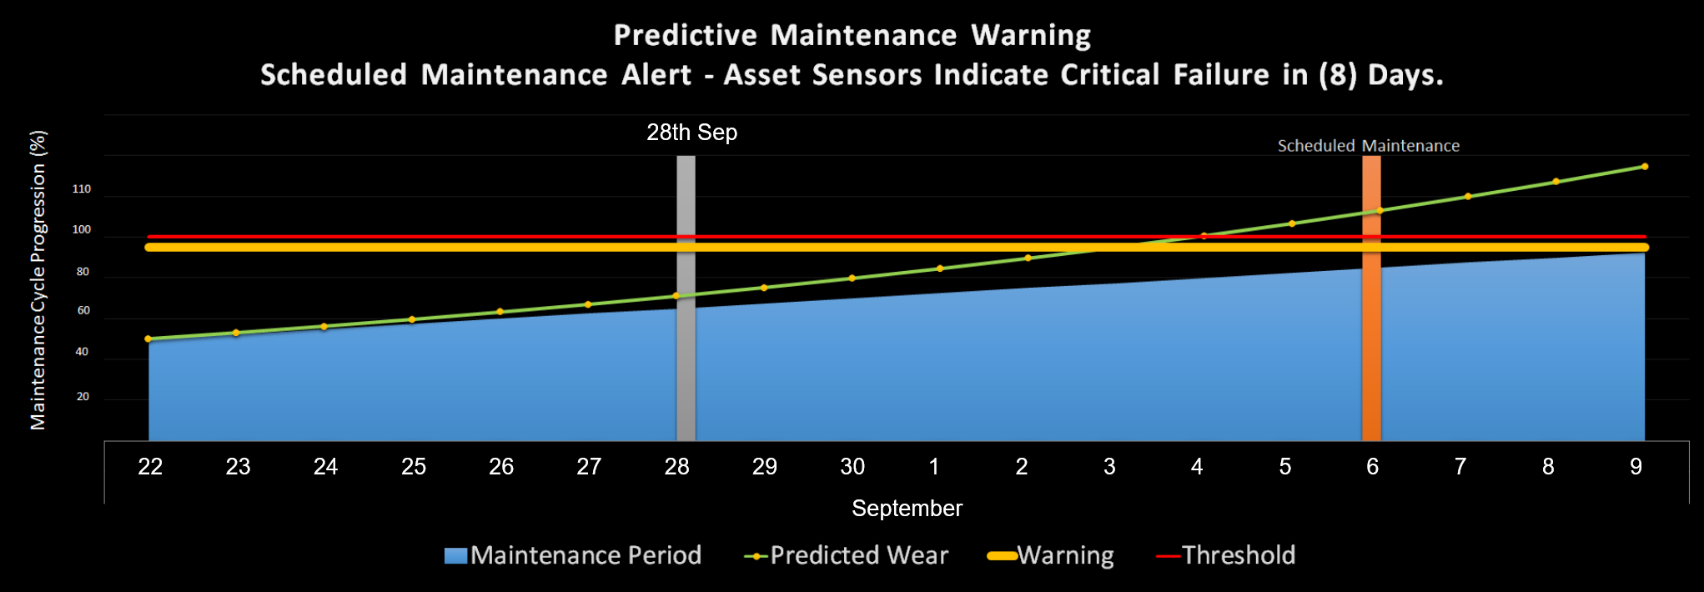
Integrated predictive analytics
Empower with proactive analysis
Machine learning solutions enable powerful predictive analytics solutions, leveraging historical data and real time device ingestion input.
Predictive Maintenance Warning
Scheduled Maintenance Alert – Asset Sensors Indicate Critical Failure in (6) Days.
Notes:
Azure Machine Learning adds a powerful predictive component to any IoT solution. Above is a powerful example (from TKE and Rockwell demos) showing how predictive algorithms analyze data and predict trends. In this case the upward movement of data shows that the asset in question will fail before its regular maintenance service is due to be carried out. This will result in a lost-time outage and decreased production. When the alert is generated and escalated the user is able to carry out the maintenance in advance, avoiding the outage. This data can also be used through the data visualization tools and deeper analysis to see if this is a wider issue. It may well be the case that this is a uniform problem across the infrastructure and service windows or certain types of parts used may need to be altered.
Machine Learning
Predictive analytics
Avoid outages by predicting issues early and proactively resolving them
Leads to deeper analysis with data visualization to diagnose wider problems

Slide 69
Cloud based predictive analytics
Use ML studio to create
Access and prepare data,
Create, test and train models
Rapid deployment
Single click deploy to production via API service
Drag and drop algorithms
Simple UI for straightforward algorithm creation
Algorithm libraries
Utilize library of preconfigured algorithm solutions
Batch Analysis
Ability to invoke (BES) Azure Web Service to use Batch Execution Activity
Use Azure Data Factory to orchestrate data movement and processing
Perform batch execution via ML endpoint
Batch Execution Service: An asynchronous service that scores a batch for data records.
Real-time API
An external application communicates with an ML workflow scoring model in real time
An ML web service call returns prediction results to an external application
Request-Response Service: A low latency, highly scalable service that provides an interface to your stateless models
Notes:
It is possible to call Azure Machine Learning either in batch form (passing up a large batch of data), or via the real time web service API.
You may encounter times when it’s necessary to take both of these approaches in your IoT solution…
In some cases exporting a large batch of data out of blob storage and running that through Azure Machine Learning.
Other times making real time API calls off the back of Azure Stream Analytics or an Azure Event Hubs job across to the Azure Machine Learning API.
Learn more here: https://azure.microsoft.com/en-us/documentation/articles/data-factory-azure-ml-batch-execution-activity
Utilize ML Studio to create models using a simple drag-and-drop decision tree method. Split data to create and test the model for accuracy. When the model is adequate it can be deployed quickly to the ML API service. This generates the model as a URL that can be called from any business endpoint.
Machine Learning
Access data,
Prepare, test and deploy models
Rapid one-click deployment
Preconfigured algorithm libraries

Slide 70
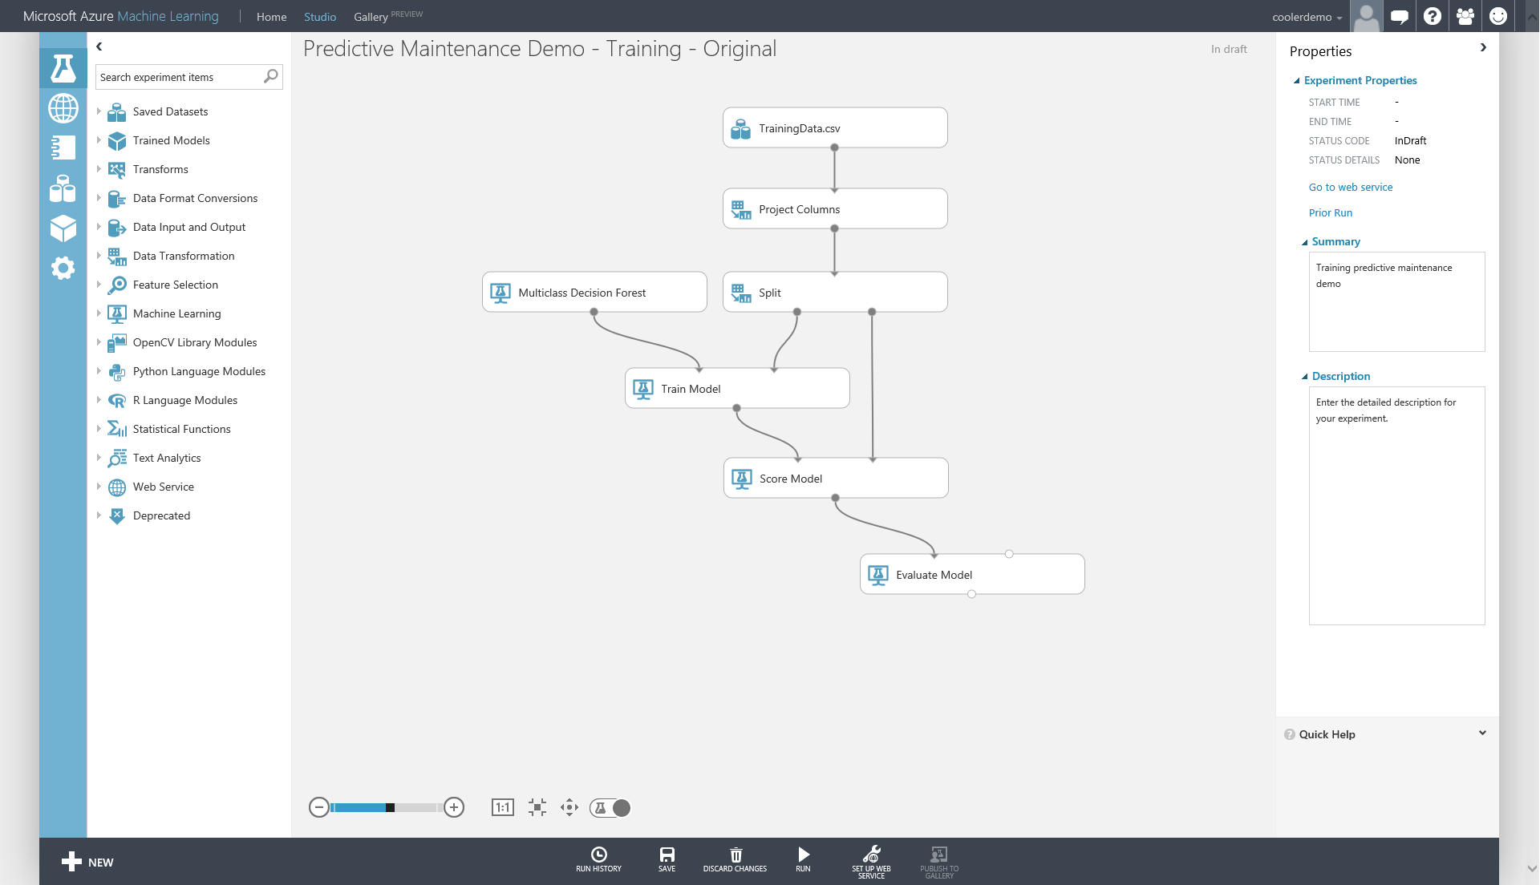
AML - Drag & Drop + Best in Class Algorithms
Notes:
Quickly build and develop complex algorithms and predictive models using ML Studio and its drag-and-drop multi class decision forest tool. Through this portal device data can be easily accessed and split into columns to test and train the model. Score the model for accuracy, generating R-squared % rankings. When the user is comfortable with the model it can be quickly deployed to the ML API service. This allows for incredibly fast model deployment and integration, as opposed to requiring data science teams to develop and deploy custom solutions.
Machine Learning
Train and test AML models
Rapid deployment

Slide 71
Microsoft Azure IoT Technical Scenario: Integrate into business systems
Notes:
For a recorded presentation by Azure IoT Program Management through C+E University: IoT Online webinar series: please visit:
https://mspartnerlp.partner.microsoft.com/LearningPath/LearningPath/DLPaths?trackId=2918&rowId=3606&trackPathId=14612

Slide 72
Elements of Azure IoT Suite
Connect and Manage Devices & Gateways
2. Analyze streaming data
3. Integrate into business systems
Preconfigured solutions
Real time analytics
Workflow integration
Gateway & Devices
Data visualization
Push and broadcast notifications
Connect and control
Predictive analytics*
ID and access management
4. Secure IoT Infrastructure
5. Customize IoT Architecture
* Only applies to Predictive Maintenance
Notes:
The Microsoft Azure IoT Suite provisions products and services within a subscription enabling an accelerated development of an IoT solution pilot or proof of concept. The elements within the Suite are highly customizable and allow for users to choose preferred OS’s, languages and platforms. Getting started and onboarding devices is simplified with documentation, libraries and SDK’s. Data processing, command and control and porting data to dashboards and LoB applications allows access to decision making information in real time. Integration with business systems and processes means business can be transformed quickly with an end-to-end Iot solution.
Microsoft Azure IoT is comprised of the following components
Connect and manage devices and gateways
Preconfigured solutions offer quick start-up provisioning to the most common IoT scenario requirements.
Heterogeneous agents libraries, documentation and SDK’s allow for OS selection and cross platform, multi language support. Easily flash devices and create custom agents using open source libraries.
Connect and control devices easily, handling device authentication and secure two way communication.
Analyze streaming data and generate predictive insights
Set thresholds, alert limits and values and alarm jobs while processing big data.
Visualize big data on dashboards or create reports for business decision makers.
Implement predictive analytics and algorithms across historical and real time data for a variety of purposes.
Integrate and transform business processes
Integrate alarms, real time processes and elevate attention within new or existing line of business applications.
Broadcast notifications and commands to devices or personnel; utilize geographic or other custom features to target audiences.
c) Make dashboards and data available but control security and access to devices, thresholds and alert configurations.
Secure IoT Infrastructure
Protecting IoT solutions requires ensuring secure provisioning of devices, secure connectivity between these devices and the cloud, and secure data protection in the cloud during processing and storage. Working against such functionality, however, are resource-constrained devices, geographic distribution of deployments, and a large number of devices within a solution..
5) Customize IoT Architecture
Not everyone will want to or is positioned to avail of IoT Suite’s pre-configured solutions and will instead want to customize their IoT solution using individual services.

Slide 73
Workflow Integration Logic Apps
Notes:
Logic Apps provide a way to simplify and implement scalable integrations and workflows in the cloud.
It provides a visual designer to model and automate your process as a series of steps known as a workflow.. A logic app begins with a trigger (like 'When an account is added to Dynamics CRM') and after firing can begin many combinations actions, conversions, and condition logic.
The advantages of using Logic Apps include the following:
Saving time by designing complex processes using easy to understand design tools
Implementing patterns and workflows seamlessly, that would otherwise be difficult to implement in code
Getting started quickly from templates
Customizing your logic app with your own custom APIs, code, and actions
Connect and synchronise disparate systems across on-premises and the cloud
Build off of BizTalk server, API Management, Azure Functions, and Azure Service Bus with first-class integration support
Logic Apps is a fully managed iPaaS (integration Platform as a Service) allowing developers not to have to worry about building hosting, scalability, availability and management. Logic Apps will scale up automatically to meet demand.

Slide 74

Integrate with business systems
Create workflows
Visually create processes and workflow, automated actions and trigger responses
Cross platform
Integrate with new, existing or custom business solutions on any platform
Connect to on-premises data
Utilize on-prem/cloud hybrid integration solutions
Standard and custom connectors
Library of supported external connectors, or create custom ones
Line of business integration
Push intelligence, alerts and alarms to existing LoB dashboards or solutions
Highly automated
Automate EA, B2B and business processes
API connections
Authenticate once and reuse
Differentiate connection configuration
Simple to deploy
Portal experience for managing API Connections
Cloud APIs and platform functionality
Dozens of built-in connectors
Hosted and managed within the platform
Scales to meet your needs
First class designer experience
Rapid development
Managed Connectors
Notes:
Workflows and connections can be integrated and highly automated with Logic Apps. Utilize cross-platform capabilities and connect to both cloud and on-prem data flows. Standard, premium and customer connectors are available and easily integrated with a drag and drop UI in the Azure Management Portal.
Logic App Concepts
The following are some of the key pieces that comprise the Logic Apps experience.
Workflow - Logic Apps provides a graphical way to model your business processes as a series of steps or a workflow.
Managed Connectors - Your logic apps need access to data and services. Managed connectors are created specifically to aid you when you are connecting to and working with your data. See the list of connectors available now in managed connectors.
Triggers - Some Managed Connectors can also act as a trigger. A trigger starts a new instance of a workflow based on a specific event, like the arrival of an e-mail or a change in your Azure Storage account.
Actions - Each step after the trigger in a workflow is called an action. Each action typically maps to an operation on your managed connector or custom API apps.
Enterprise Integration Pack - For more advanced integration scenarios, Logic Apps includes capabilities from BizTalk. BizTalk is Microsoft's industry leading integration platform. The Enterprise Integration Pack connectors allow you to easily include validation, transformation, and more in to your Logic App workflows.
Getting Started
To get started with Logic Apps, follow the create a Logic App tutorial.
View common examples and scenarios
You can automate business processes with Logic Apps
Learn How to Integrate your systems with Logic Apps
Why Logic Apps?
Logic Apps brings speed and scalability into the enterprise integration space. The ease of use of the designer, variety of available triggers and actions, and powerful management tools make centralizing your APIs simpler than ever. As businesses move towards digitalization, Logic Apps allows you to connect legacy and cutting-edge systems together.
Additionally, with our Enterprise Integration Account you can scale to mature integration scenarios with the power of a XML messaging, trading partner management, and more.
Easy to use design tools - Logic Apps can be designed end-to-end in the browser or with Visual Studio tools. Start with a trigger - from a simple schedule to when a GitHub issue is created. Then orchestrate any number of actions using the rich gallery of connectors.
Connect APIs easily - Even composition tasks that are easy to describe are difficult to implement in code. Logic Apps makes it easy to connect disparate systems. Want to connect your cloud marketing solution to your on-premises billing system? Want to centralize messaging across APIs and systems with an Enterprise Service Bus? Logic apps are the fastest, most reliable way to deliver solutions to these problems.
Get started quickly from templates - To help you get started we've provided a gallery of templates that allow you to rapidly create some common solutions. From advanced B2B solutions to simple SaaS connectivity, and even a few that are just 'for fun' - the gallery is the fastest way to get started with the power of Logic Apps.
Extensibility baked-in - Don't see the connector you need? Logic Apps is designed to work with your own APIs and code; you can easily create your own API app to use as a custom connector, or call into an Azure Function to execute snippets of code on-demand.
Real integration horsepower - Start easy and grow as you need. Logic Apps can easily leverage the power of BizTalk, Microsoft's industry leading integration solution to enable integration professionals to build the solutions they need. Find out more about the Enterprise Integration Pack.

Slide 75











Integrate with business systems
Drag and drop interface
No coding
Leverage existing templates
Standard connectors
Triggers and actions for over 60 services
Enterprise connectors
MQ & SAP Connector
B2B Scenarios
Electronic Data Interchange
Custom connectors
Create custom connectors and API’s
Notes:
Workflows and connections can be integrated and highly automated with Logic Apps. There are many connectors across the cloud and on-premises to quickly integrate across services and protocols
Utilize cross-platform capabilities and connect to both cloud and on-prem data flows. Standard, premium and customer connectors are available and easily integrated with a drag and drop UI in the Azure Management Portal.
Connectors can be triggers
Several connectors provide triggers that can notify your app when specific events occur. For example, the FTP connector has the OnUpdatedFile trigger. You can build either a Logic app, PowerApp or Flow that listens to this trigger and takes an action whenever the trigger is fired.
There are two types of triggers:
Poll Triggers: These triggers poll your service at a specified frequency to check for new data. When new data is available, a new instance of your app runs with the data as input. To prevent the same data from being consumed multiple times, the trigger may clean up data that has been read and passed to your app.
Push Triggers: These triggers listen for data on an endpoint or for an event to occur, then, triggers a new instance of your app. The Twitter connector is one such example.
Connectors can be actions
Connectors can also be used as actions within your apps. Actions are useful for looking up data which can then be used in the execution of your app. For example, you may need to look up customer data from a SQL database when processing an order. Or, you may need to write, update or delete data in a destination table. You can do this using the actions provided by the connectors. Actions map to operations that are defined in the Swagger metadata.
Standard connectors
Azure HDInsights, Azure Service Bus, Azure Storage Blob, Box, Chatter, DropBox, Facebook, FTPS, HTTP, Microsoft Office 365, Microsoft OneDrive, Microsoft SharePoint, Microsoft SQL Server, Microsoft Yammer, POP3, QuickBooks, SFTP, SMTP, Salesforce, SugarCRMC, Twilio, Twitter
Premium connectors
AS2 Connector, BizTalk EDIFACT, BizTALK X12, BizTALK Trading Partner Management, BizTALK JSON Encoder, BizTALK Rules, DB2 Connector, Informix, MQ, Oracle DB, SAP, BizTALK Flat File Encoder, BizTALK Transform Service, BizTALK XML Validator, BizTALK Xpath Extractor

Slide 76
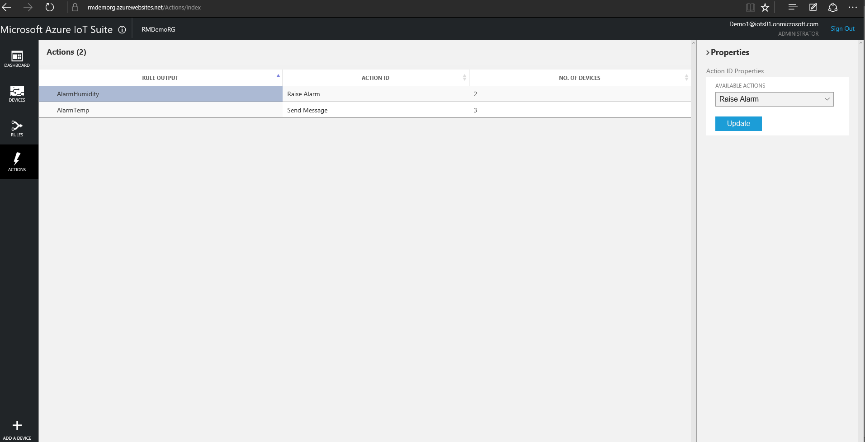
Notes:
Logic Apps are used to create and manage complex workflows, integrating ingested data, alarms and alerts into line of business and existing applications. The Logic Apps UI is exposed within the IoT Suite to allow simple rule creation to outline the flow of information if an alert or alarm is created.
Logic Apps
Integrate with LoB applications
Simple rule/trigger creation

Slide 77
Push & Broadcast Notifications Notification Hubs
Notes:
Notification Hubs – Push & Broadcast Notifications
Azure Notification Hubs provide an easy-to-use, multiplatform, scaled-out push infrastructure that enables you to send mobile push notifications from any backend (in the cloud or on-premises) to any mobile platform.
With Notification Hubs, you can easily send cross-platform, personalized push notifications, abstracting the details of the different platform notification systems (PNS). With a single API call, you can target individual users or entire audience segments containing millions of users, across all their devices.
You can use Notification Hubs for both enterprise and consumer scenarios. For example:
Send breaking news notifications to millions with low latency (Notification Hubs powers Bing applications pre-installed on all Windows and Windows Phone devices).
Send location-based coupons to user segments.
Send event notifications to users or groups for sports/finance/games applications.
Notify users of enterprise events like new messages/emails, and sales leads.
Send one-time-passwords required for multi-factor authentication.

Slide 78
Broadcast notifications to any backend
Reach all major platforms
Support across iOS, Android, Windows, Kindle etc.
Broadcast from major backends
.Net, PHP, Java, Node.js, cloud/on-prem hybrids
High capacity
Broadcast to millions of devices from a single API call
Customize audience
Target devices based on location, language, status
Scale instantly
Ramp up and deploy to millions of devices without the need to re-architect the solution
Secure communication
PNS managed authentication credentials per device, per message
Receipt telemetry
PNS managed authentication credentials per device, per message
Notes:
Broadcast to all, or some, of your devices using Notification Hubs. All major platforms can be reached from most major backends including cloud/on-prem hybrid solutions. Easily push messages to many millions of devices using a single API call. Message audiences can be tailored by location, language, status etc. Read receipt telemetry is available securely (PNS managed authentication creds per/device, per/message) to track which devices are communicating properly. Instantly ramp up to millions of devices without the need to rearchitect the system.
Push Notifications
Reach all major platforms
Customize target audience – location/device/language/stauts
Broadcast to millions with single API call
Secure communication and telemetry

Slide 79
Push Notifications
Register device handle at app launch
Client app retrieves handle from Platform Notification Service (PNS)
App passes the handle to the back-end
Send Notification
App back-end sends notification to Platform Notification Service (PNS), uses PNS credentials to authenticate
PNS pushes the notification to the app on the device
Maintain device handles
Backend deletes expired handles when PNS rejects them
Maintain mapping between logical users/groups and device handles
1
1
2
4
Client app
2
3
3
Platform
Notification
Service
4
5
5
6
App back-end
6
Notes:
Notification Hubs Reference Architecture
Push notifications are delivered through platform-specific infrastructures called Platform Notification Systems (PNS). A PNS offers barebones functions (that is, no support for broadcast, personalization) and have no common interface. For instance, to send a notification to a Windows Store app, a developer must contact the WNS (Windows Notification Service). To send a notification to an iOS device, the same developer has to contact APNS (Apple Push Notification Service), and send the message a second time. Azure Notification hubs help by providing a common interface, along with other features to support push notifications across each platform.
At a high level, though, all platform notification systems follow the same pattern:
The client app contacts the PNS to retrieve its handle. The handle type depends on the system. For WNS, it is a URI or "notification channel." For APNS, it is a token.
The client app stores this handle in the app back-end for later usage. For WNS, the back-end is typically a cloud service. For Apple, the system is called a provider.
To send a push notification, the app back-end contacts the PNS using the handle to target a specific client app instance.
The PNS forwards the notification to the device specified by the handle.

Slide 80
ID & Access Management Azure Active Directory
Notes:
ID & Access Management – Azure Active Directory

Slide 81
Sharing and access control
Secure access
Easily manage credential based access to dashboards
Access control
Restrict access to devices, sensors, controls, thresholds and settings
Multi-factor authentication
Increased security via multi-factor authentication
Monitor usage
See who is using the solution, when and for what purpose
Mobile security
Enable secure mobile access to on-premises applications
Notes:
Simply manage user access and control what functions and dashboards certain users have access to. Share device data and real time information flows without allowing access to the rules and thresholds, or devices themselves. Monitor usage around which assets and dashboards are being used, and by whom. Ensure multi-factor authentication as well as security for access via mobile devices.
Azure Active Directory
Share with users and manage access to various components
Access control to devices/dashboards
Monitor usage
Mobile security

Slide 82
Business Insights and Actions
Transform your Business

Slide 83
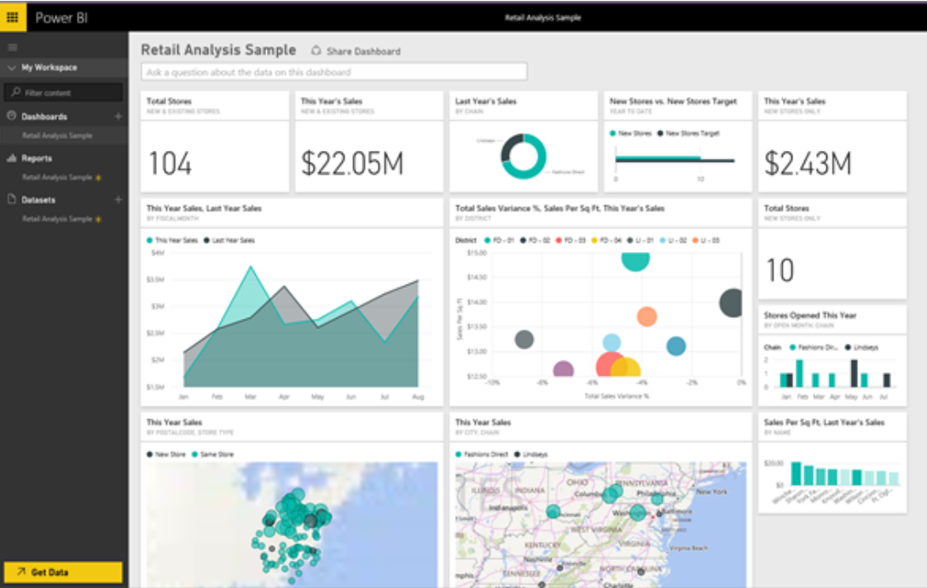
Power BI – Visualize and act on your data
Visualize in one place
Create and share dashboards
Access addition data sources
Track business metrics
Analyze and act
Interact with data in real-time
Build models over your data
Embed into your App
Notes:
Power BI transforms your company's data into rich visuals for you to collect and organize so you can focus on what matters to you.
Your whole business on one dashboard
With Power BI on the web, monitor your important data from across your organization and from all of the apps you rely on.
Create stunning interactive reports
Power BI Desktop gives you tools to transform, analyze, and visualize data. Share reports in seconds with your organization using Power BI on the web.
Consistent analysis across your organization
With SQL Server Analysis Services on-premises and Azure Analysis Services in the cloud you can easily build robust, reusable models over your data to provide consistency across reporting and analysis in your organization.
Easily embed BI and analytics in your app
Deliver stunning interactive reports in your app with the Power BI Embedded service.

Slide 84
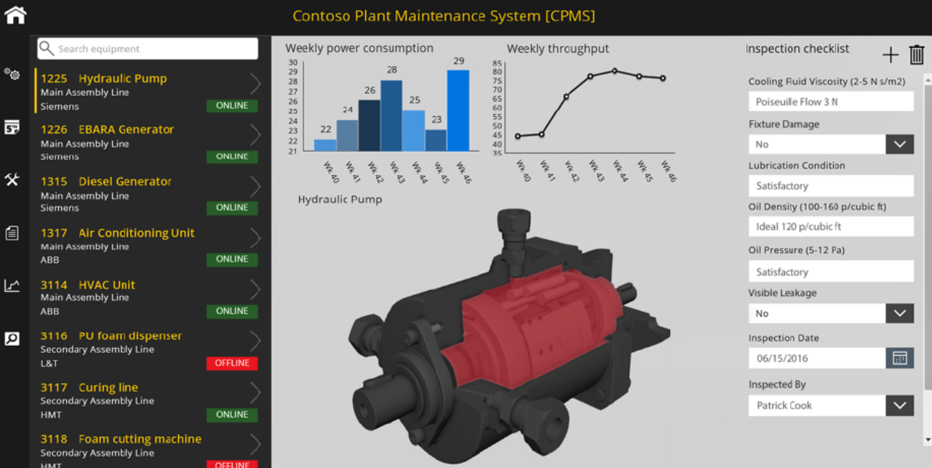
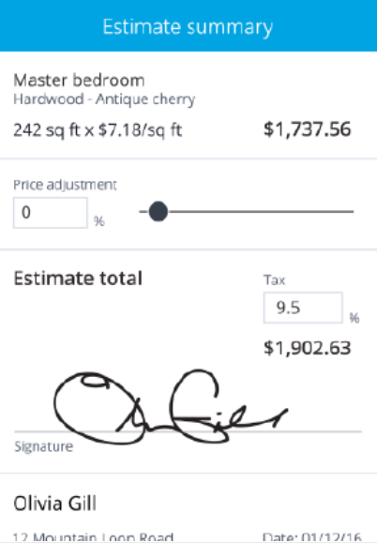
PowerApps – Apps by business leaders
Create business applications
Connect to your systems
Build apps without writing code
Publish and use on mobile and web
Transform your business
Help coworkers automate tasks and get more done
Empower your team to work from anywhere on any device
Business leaders can quickly refine business processes
Notes:
Get started quickly
Get inspired with pre-built templates, or start from scratch. You already have everything that you need to get started building apps that mean business.
Do more with your data
Connect to services you're already using like Excel, SharePoint, Dynamics 365, and more to automatically generate apps, or use the Common Data Service to capture new data.
Turn your expertise into apps
Understand the business problem? Now you can build the solution. Work in a visual designer to customize fully functional apps — without having to write code.
An advanced data service built right in
The Common Data Service is a secure business data platform built into PowerApps. It comes with hundreds of standard business entities already defined, which means that now all your apps can share the same definition of “customer,” “product,” “lead,” and more. The service also includes workflow automation with Microsoft Flow.
Instantly publish apps to the web or mobile
When done, get your app in people’s hands. Publish it to your organization—no app store required. Web and mobile. Laptops, tablets, and phones. Android, iOS, and Windows.

Slide 85

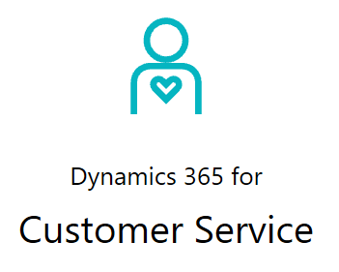
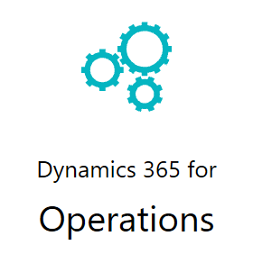
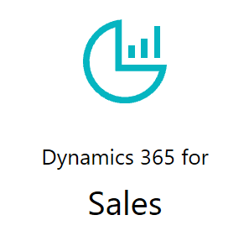
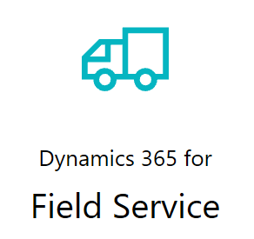
Dynamics 365 – CRM and ERP
Intelligent business applications
Enterprise Business Solutions
Integrate directly to Azure Cloud Services
Work smarter with connected operations
Dynamics 365 Field Service
Optimized scheduling
Connected devices in the field help them see—and solve—problems before customers even know about them.
Lower costs by dispatching technicians only when they’re needed
Notes:
Engage your customers
With digital intelligence on your side, you fill every customer interaction with personalized insight. And your conversations feel more fluid and natural across every touch point.
Empower your employees
Dynamics 365 provides the insights your people need to make the best decisions and the tools they need to do their best work—ensuring great outcomes from your business software.
Optimize your operations
With complete ERP capabilities to streamline your operations and reduce your costs, Dynamics 365 enterprise business solutions help you grow your business and your bottom line.
Transform your products
By embedding technology into your products, you can start using shared data and digital intelligence to generate new insights, products, and business models—and discover new revenue sources.

Slide 86
Microsoft Azure IoT Technical Scenario: Securing IoT Infrastructure
Notes:
For a recorded presentation by Azure IoT Program Management through C+E University: IoT Online webinar series: please visit:
https://mspartnerlp.partner.microsoft.com/LearningPath/LearningPath/DLPaths?trackId=2918&rowId=3606&trackPathId=14612

Slide 87
Elements of Azure IoT Suite
Connect and Manage Devices & Gateways
2. Analyze streaming data & Generate predictive insights*
3. Integrate into business systems
Preconfigured solutions
Real time analytics
Workflow integration
Gateway & Devices
Data visualization
Push and broadcast notifications
Connect and control
Predictive analytics*
ID and access management
4. Secure IoT Infrastructure
5. Customize IoT Architecture
* Only applies to Predictive Maintenance
Notes:
The Microsoft Azure IoT Suite provisions products and services within a subscription enabling an accelerated development of an IoT solution pilot or proof of concept. The elements within the Suite are highly customizable and allow for users to choose preferred OS’s, languages and platforms. Getting started and onboarding devices is simplified with documentation, libraries and SDK’s. Data processing, command and control and porting data to dashboards and LoB applications allows access to decision making information in real time. Integration with business systems and processes means business can be transformed quickly with an end-to-end Iot solution.
Microsoft Azure IoT is comprised of the following components
Connect and manage devices and gateways
Preconfigured solutions offer quick start-up provisioning to the most common IoT scenario requirements.
Heterogeneous agents libraries, documentation and SDK’s allow for OS selection and cross platform, multi language support. Easily flash devices and create custom agents using open source libraries.
Connect and control devices easily, handling device authentication and secure two way communication.
Analyze streaming data and generate predictive insights
Set thresholds, alert limits and values and alarm jobs while processing big data.
Visualize big data on dashboards or create reports for business decision makers.
Implement predictive analytics and algorithms across historical and real time data for a variety of purposes.
Integrate and transform business processes
Integrate alarms, real time processes and elevate attention within new or existing line of business applications.
Broadcast notifications and commands to devices or personnel; utilize geographic or other custom features to target audiences.
c) Make dashboards and data available but control security and access to devices, thresholds and alert configurations.
Secure IoT Infrastructure
Protecting IoT solutions requires ensuring secure provisioning of devices, secure connectivity between these devices and the cloud, and secure data protection in the cloud during processing and storage. Working against such functionality, however, are resource-constrained devices, geographic distribution of deployments, and a large number of devices within a solution..
5) Customize IoT Architecture
Not everyone will want to or is positioned to avail of IoT Suite’s pre-configured solutions and will instead want to customize their IoT solution using individual services.

Slide 88
Why securing Internet of Things is hard
System of Systems
Information
Technology
Operational
Technology
Notes:
Securing IoT is very challenging since we are talking about 2 different worlds with different mission and security challenges
IT – Information Technology
OT – Operational Technology
Information Technology (IT) the application of computers and telecommunications equipment to store, retrieve, transmit and manipulate data*
Mission of IT
Design and maintain software, hardware and network resources which run securely and provide privacy
Operations Technology (OT)
collects information and causes changes in the physical world through the direct monitoring and control of physical devices in industrial contexts
Mission of OT
Design and maintain machines which run reliably, and safely (do not cause injury or harm to other machines, humans, and the environment)

Slide 89
Why securing Internet of Things is hard
System of Systems
Information
Technology
Specialists
Hardware
Device
Specialists
Notes:
The combination of both IT and OT is what makes IoT and creates what we call System of Systems
Integration of IT and OT
Compromise of safety because of lack of security
Machine‘s control sequnece modified without access control (lack of information integrity)
Compromise of reliablity because of lack of security
Modified operation controls can cause machines to become less reliable (malicious outsider or insider threat)
Leakage of business process secrets
Realtime business process details stolen (confidentiality of information)

Slide 90
Trustworthy Internet of Things
Environment
Threats
Security
Privacy
Trustworthy
IoT
Reliability
Safety
System faults
Human errors
Notes:
In order to have a Trustworthy Internet of Things it is important to take into consideration the following aspects:
Security
Privacy
Safety
Reliability
In addition, threats may come from several directions
Threats
System Faults
Human Errors
Environment

Slide 91
Azure IoT Suite security features
Securely connect millions of devices . . .
Over a secure internet connection . . .
To Microsoft Azure – built with security from the ground up
101010101101010110100010101010101110100010111
1010101011001010110100010101010101110100010111
Device security
Device provisioning and authorization
Connection security
X.509/LTS-based handshake and encryption
Cloud security
Azure Security Center
Azure Active Directory
Key Vault
Policy-Based Access Control
Notes:
Organizations usually think about IoT Security in 3 buckets
Device Security
Connection Security
Cloud Security
Azure IoT Suite as Microsoft IoT Cloud Platform does have several features to help those buckets
Device Security
Device Provisioning and Authorization
Authentication: Unique identity key for each device. Generated key and user-selected device ID forms basis of token used Identity registry provides secure storage of device identities and security keys for a solutionIndividual or groups of device identities can be added to allow or block list, enabling complete control over device access
Authorization: Access control policies in the cloud enableLimiting what a device can do in the cloud (read, write, or both). Activation and disabling of any device identity Providing a way to disassociate a device when required
Connection Security
X.509/LTS-Based Handshake and Encryption
Communication path between devices and Azure IoT Hub secured using industry-standard Transport Layer Security (TLS), service authenticated using X.509 protocol
Devices protected from unsolicited inbound connections by not allowing any connection to the device. The device initiates all connections
Durably store messages for devices. Maintain a per-device queue for each device.
Cloud Security
Azure Security Center
Azure Active Directory
Key Vault
Policy-Based Access Control

Slide 92
Defense in depth – Important roles
IoT hardware manufacturer and integrator
IoT solution developer
IoT cloud and solution provider
IoT solution deployer
IoT solution operator

Slide 93
Accessing IoT Hub from cloud components
Authorization policies
Permissions
Each hub allows multiple policies
Each policy grants a set of permissions
Primary and Secondary keys
Device Connect – for any component connecting as a device (e.g. send D2C, receive C2D, …)
Service Connect – for back-end components (e.g. read D2C, send C2D, receive feedback/monitoring)
Registry Read – for provisioning components that have to read the hub’s device identity registry
Registry Write – for provisioning components that have to modify the hub’s identity registry
Notes:
IoT Hub uses the following set of permissions to grant access to each IoT hub's endpoints. Permissions limit the access to an IoT hub based on functionality.
Registry Read. Grants read access to the device identity registry.
Registry Write. Grants read and write access to the device identity registry.
Service Connect. Grants access to cloud service-facing communication and monitoring endpoints. For example, it grants permission to backend cloud services to receive device-to-cloud messages, send cloud-to-device messages, and retrieve the corresponding delivery acknowledgments.
Device Connect. Grants access to device-facing communication endpoints. For example, it grants permission to send device-to-cloud messages and receive cloud-to-device messages. This permission is used by devices.
Per-device security credentials: each IoT Hub contains a device identity registry. For each device in this registry, you can configure security credentials that grant DeviceConnect permissions scoped to the corresponding device endpoints.
Device Identity Registry: used to enable and disable authentication and authorization for each given device which has been registered into the IoT Hub.

Slide 94
Microsoft Azure IoT Technical Scenario: Create Custom Architectures for Your IoT Scenarios

Slide 95
Elements of Azure IoT Suite
Connect and Manage Devices & Gateways
2. Analyze streaming data
3. Integrate into business systems
Preconfigured solutions
Real time analytics
Workflow integration
Gateway & Devices
Data visualization
Push and broadcast notifications
Connect and control
Predictive analytics*
ID and access management
4. Secure IoT Infrastructure
5. Customize IoT Architecture
* Only applies to Predictive Maintenance
Notes:
Not everyone will want to or is positioned to avail of IoT Suite’s pre-configured solutions and will instead want to customize their IoT solution using individual services.
And this customization will be the focus of today’s webinar. There are many challenges, complexities and considerations to keep in mind as you design an end to end architecture

Slide 96
IoT architecture challenges
Network and protocol
Security, Privacy and Trust
Heterogeneity
Serialization
Streaming Throughput
Cost
Data Volume
Auto-discovery
Legacy and fragmentation
Notes:
Network Foundation—limitations of the current Internet architecture in terms of device mobility, availability, manageability and scalability are some of the major barriers to IoT. Non-IP requires gateway, intermittent connectivity requires device synchronization between device and cloud
Security: (a)securing the architecture of IoT– security to be ensured at design time and execution time,(b) proactive identification and protection of IoT from arbitrary attacks (e.g. DoS and DDoS attacks) and abuse, and (c) proactive identification and protection of IoT from malicious software.
Privacy: control over personal information(data privacy) and control over individual’s physical location and movement(location privacy), (b) need for privacy enhancement technologies and relevant protection laws, and (c) standards, methodologies and tools for identity management of users and objects.
Trust: (a) Need for easy and natural exchange of critical, protected and sensitive data—e.g. smart objects will communicate on behalf of users / organizations with services they can trust, and (b) trust has to be a part of the design of IoT and must be built in
Managing heterogeneity—managing heterogeneous applications, environments and devices constitute a major challenge
Transport protocol options and the limitations and capabilities of each is a challenge for our customers, when to use AMQP and when to use MQTT?
Data serialization and format could also be a challenge, what is the best data format, does the platform support it, how do I encrypt/decrypt if the platform does not support it?
High Throughput might be a challenge for scenarios like Connected Car where you have millions of devices in the same region and need a ms response for a round-trip request. Throughput requirements are influencing architecture design.
Cost: being able to estimate Number of Devices, Number of Messages per Day, Bytes per Message of your platform and estimating what is the optimal cost for optimal combination of services could also be a challenge.
Large data set: large amount of information and mining large volume of data to provide useful services, designing an efficient architecture for sensor networking and storage
Autodiscovery: designing mechanisms for device data discovery designing sensor data communication protocols— sensor data query, publish/subscribe mechanisms,(e) developing sensor data stream processing mechanisms, and (f) sensor data mining—correlation, aggregation filtering techniques design. Finally, standardizing heterogeneous technologies, devices, application interfaces etc. will also be a major challenge.
The reference architecture provides a degree of component commonality that allows assembling secure, complex solutions supporting extreme scale, and yet allowing for maximum flexibility with regard to possible solution scenarios. This motivates the following guiding principles across the different areas of the architecture.
Heterogeneity. The proposed reference model must accommodate for a vast variety of scenarios, environments, devices, processing patterns, and standards. It should be able to handle vast hardware and software heterogeneity.
Security. Because IoT solutions represent a powerful connection between the digital and physical worlds, building secure systems is a necessary foundation for building safe systems. This reference model contemplates security and privacy measures across all areas, including device and user identity, authentication and authorization, data protection for data at rest and data in motion, as well as strategies for data attestation.
Hyper-scale deployments. The proposed architecture should support millions of connected devices. It should allow proof-of-concepts and pilot projects that start with a small number of devices to be scaled-out to hyper-scale dimensions.
Flexibility. The heterogeneous needs of the IoT market necessitate open-ended composition of various services and components. The reference model is built upon a principle of composability to allow for a number of extension points and to enable the usage of various first-party or third-party technologies for the individual conceptual components. A high-scale, event-driven architecture with brokered communication is the backbone for a loosely coupled composition of services and processing modules.

Slide 97
IoT architecture characteristics/variables
Message Type
Message Speed
Message Frequency
Device Volume
Message Volume
Connectivity Level
Data structure
Communication direction
Notes:
This means that you must consider certain architecture characteristics:
Message Type: Do you need to deal with Telemetry stream, Alerts, Bulk telemetry
Message Speed: what kind of response or latency do you need Fast Response, Late Response
Message Frequency: Low, Med, High
Device Volume: Low, Med, High
Message Volume: Low, Med, High
Connectivity Level: Intermittent, Low bandwidth, High bandwidth
Data structure: Individual, Batched
Communication direction: One-way, Bi-directional
Customers want to send data all sorts of ways, and they have many constraints and options that influence the IoT architectures and solutions. In this slide I am going to talk about the characteristics or variables that go into device data transfer scenarios and what could be the suggestions for each of them.
For example : Message Type: could be of multiple types: Telemetry, Priority alerts, Batched telemetry, indivisible file upload.
Usually Telemetry requires high uptime and a stream processor reading off the other end. This can often be combined with cold storage, where the stream is both analyzed and also written to blob or Data Lake.
- Alerts: These are messages that require immediate attention and should go to a queue rather than a stream processor for immediate processing. We would architect this using an IoT Hub Message Route to a SB queue.
Batch/Bulk telemetry: Telemetry data over a period of time is aggregated and uploaded to a central location at known intervals. The data is compressed into a file which will then be sent as one chunk, and the data may be encrypted. Here we would architect it using IoT Hub File Upload feature to upload the data directly to a Blob Storage
So, there are multiple characteristics which are influencing the architecture:
Message Speed : this is the speed of messages required for example for a backend service, it could be “Must respond now” or it could respond later”. In the case of immediate response, we need a mechanism similar with IoT Hub Twin Direct Method which is similar with Http request/reply. I could not use a regular C2D message cause device might have an issue and not respond and I need a way to know if the device is offline or not to take a decision of rebooting the device or not. So I need a synchronous mechanism and not asynchronous. If it’s late response, I could use C2D messages.
In a similar way message volume, message frequency, number of devices, number of messages/day, connectivity level and data structure are changing the elements you could pick for an IoT architecture.
If I have low bandwidth device (e.g. metered connection) and a non-IP capable device, than I need to have a gateway which is located on the edge and could communicate to my device and the gateway will talk to a Cloud Gateway.

Slide 98
IoT real-life use cases and scenarios
Industry | Use case | Scenarios patterns
Manufacturing | Connected Vehicle Food Traceability Production Asset Mgmt Manufacturing Operations Connected Field Service
Consumer | Home Security Smart Appliances
Government | Automated Public Transit Environmental Monitoring Detection Public Infrastructure Asset Mgmt Public Safety and Emergency Response
Healthcare | Remote Health Monitoring Clinical Care Personal Wellness Connected Medical Device
Retail | In-Store Consumer Digital Offer Personalized promotion
Transportation | Air traffic monitoring Asset Fleet management Freight monitoring
Utility | Smart grid Smart Building
Device Connectivity & Management
Multi-protocol support
Connect legacy devices without replacing existing infrastructure
Remote Monitoring
Command and Control
Service customer equipment
Edge computing
Security & Environmental Monitoring
Real-time analytics
Data Transformation and Routing
Predictive Maintenance
Role Based Access Control
Alerts and Notification
Data Visualization
Integration with other business services
Process atomic and batch data stream
Manage Intermittent-Connected Devices
Data security from connectivity to storage
Geo-availability
Notes:
As you can see the scenario patterns are common across industries and use cases. These scenarios influence the architecture of the solution. For example connecting a legacy device without replacing the infrastructure requires a gateway or custom work to translate protocols. Or managing intermittently connecting devices requires device management features and attributes.
The most common characteristics are

Slide 99


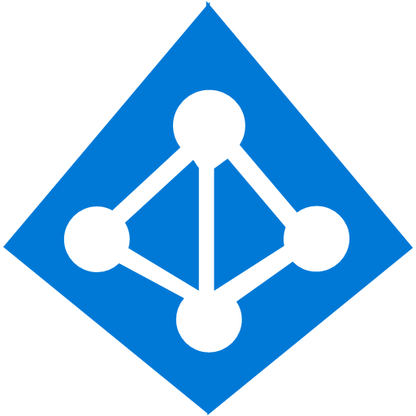

























































Which services to choose?
Platform Services
Security & Management
Hybrid
Cloud
Media & CDN
Application Platform
Data
Security Center
SQL
Database
Azure AD
Health Monitoring
Media Services
Media Analytics
Content Delivery
Network
Web
Apps
Mobile
Apps
SQL Data
Warehouse
DocumentDB
Portal
AD Privileged
Identity
Management
Azure Active
Directory
Integration
SQL Server
Stretch Database
Redis
Cache
Storage
Tables
Azure
Search
API
Apps
Cloud
Services
Azure AD
B2C
API
Management
BizTalk
Services
Domain Services
Service
Fabric
Notification
Hubs
Intelligence
Multi-Factor
Authentication
Logic
Apps
Service Bus
Functions
Cognitive Services
Bot Framework
Cortana
Backup
Automation
Developer Services
Analytics & IoT
Operational
Analytics
Compute Services
Scheduler
HDInsight
Machine
Learning
Stream Analytics
Container
Service
VM
Scale Sets
Visual Studio
Mobile
Engagement
Import/Export
Key Vault
Data
Catalog
Data Lake
Analytics Service
Data Lake Store
Store/
Marketplace
Batch
RemoteApp
VS Team Services
Xamarin
Azure Site
Recovery
Application
Insights
HockeyApp
IoT Hub
Event
Hubs
Data
Factory
Power BI
Embedded
VM Image Gallery
& VM Depot
Dev/Test Lab
StorSimple
Infrastructure Services
Compute
Storage
Networking
Virtual Machines
Containers
Blob
Queues
Files
Disks
Virtual Network
Load Balancer
DNS
Express
Route
Traffic Manager
VPN Gateway
App
Gateway
Notes:
Now the question is what Azure service you should use in your IoT architecture? In this presentation I will touch on most common used services necessarily to address 90% of the IoT architectures.

Slide 100


Azure IoT reference architecture
Device Connectivity and Management
Data Processing, Analytics and Management
Business Connectivity
Cloud Gateway
Stream Processors
Solution UX
IP capable devices
6
Custom Protocol Gateway
(Cloud Service, VM)
4
Personal mobile devices
IoT Client
Storage
Analytics & Machine Learning
1
7
8
11
3
Existing IoT devices
Business Integration
IoT Client
10
Gateway
Device Metadata
App Backend
9
Business systems
Low power devices
2
IoT Client
Existing Flow
JVM/ Azure Container Service
Intelligence and Interaction* (HoloLens, Cortana, Oxford, etc)
Data Path
Optional solution component
Device provisioning
Azure IoT solution component
5
Notes:
This is the Azure IoT Reference architecture that we recommend as the base for most of your vertical architectures. We do have a public whitepaper for this architecture where we explain all components needed to implement a complete E2E IOT solution.
While you might not need every component in your architecture, it’s important to understand how these components are working, what is their roles, so you understand how to best use it to tailor it to your needs.
Now let’s look into these main components to understand their role

Slide 101
Device connectivity
Custom Protocol Gateway
(Cloud Service, VM)
1
https://github.com/Azure/azure-iot-sdks
Device
Custom Protocols
2
https://github.com/Azure/azure-iot-gateway-sdk
IoT Client
1
3
https://github.com/Azure/azure-iot-protocol-gateway
3
Device
AMQP, MQTT, HTTPS
IoT Hub
IoT Client
AMQP, MQTT, HTTPS
Device
Gateway*
AMQP, MQTT, HTTPS
CoAP, AllJoyn, OPC
Device
Gateway SDK
2
Device
Data Path
Gateway
Custom Protocol Gateway
(Cloud Service, VM)
Optional solution component
OPC, HTTP, CoAP
Azure IoT solution component
Scenarios addressed:
Heterogeneity
Network & Transport protocol
CoAP, AllJoyn, OPC
Device
Gateway SDK
VPN/ExpressRoute
* Gateway is currently a concept that may represent Microsoft, 3rd party or custom capabilities at a hardware or software level
Notes:
First are the device connectivity components, they are 3 of them: Device SDK, Gateway SDKs and Protocol Gateway or Protocol Adaptor, Please notice in this architecture diagram the multiple ways devices are connected to the Cloud gateway (which in this case in IoT Hub),so they could connect directly to IoTHub if they support natively HTTP, AMQP, MQTT protocols, or via Gateway for low constrained devices or those which speak CoAP or OPC protocols.
We offer open source for all these SDKs, broad range of OS platforms and devices, from microcontrollers (ARM mbed), RTOS, Linux, Windows, but also Android and iOS via Xamarin
Multi language, like C, C#, JS, Java and Python
Let’s talk about recommendations of connectivity and transport protocol:
MQTT: is a lightweight client-server transfer protocol for messages. MQTT is attractive for constrained devices, because it is extremely dense with a very small footprint on the device, and for message frames (and respectively network bandwidth).
- AMQP: is a robust, connection-oriented, multiplexing message transfer protocol with inherent, compact data encoding. It provides optimizations for continuously connected devices, high-throughput communication
We also support AMQP/MQTT over websockets today which is of benefit for those environments which block non-web Internet connections using a firewall,
HTTP is optimized for request/reply and it’s used around relatively short client and server interactions
I am not going to talk about these 3 components, I’ve covered them in the first webinar, which is “Connect, manage devices and gateways”, so I am inviting you to watch the recording.
We also have a feature in IoTHub, is File Upload which is used for moving batch data directly into storage for scenarios where data is > 256KB (cold path) and this is recommended instead of direct upload to storage because IoTHub maintains the storage account keys and user gets a notification when the file is uploaded.

Slide 102
Cloud gateway
4
IoT Hub
 | Device Monitoring
 | Device Identity and Registry
 | Device Management
 | Telemetry / Command
 | Routes
 | File Upload
 | Secure
Area | IoT Hub | Event Hub
Communication Pattern | Device-to-cloud event ingress and cloud-to-device messaging. | Only event ingress (device-to-cloud scenarios)
Security | Per-device identity and revocable access control. | Event Hub-wide Shared Access Policies, with limited revocation support using publisher's policies.
Scale | Millions of simultaneously connected devices. | Limited number of simultaneous connections: up to 5000 AMQP connection.
Device state information | Device twins can store and query device state information. | No device state information can be stored.
Device direct RPC methods | Yes | No
Operations | Individual device authentication errors, throttling, and bad format exceptions. | Exposes only aggregate metrics.
File Upload | Yes | Not supported.
Device SDK | Large variety of platforms and languages, OS. | Supported on .NET, C.
Device protocol | MQTT, MQTT over WebSockets, AMQP, AMQP over WebSockets, HTTP and Protocol Adapter | MQTT, MQTT over WebSockets, AMQP, AMQP over WebSockets, and HTTP
Event Hub
Notes:
Device-to-cloud event ingress and cloud-to-device messaging, support per-device identity,
Recommandation:Event Hub vs IoT Hub
Event Hub is ingest only
Can support a more limited number of simultaneous connections--up to 5,000 AMQP connections
IoT Hub supports per device security
IoT Hub supports millions of simultaneous connections, Event Hubs only 5000 AMQP connections
IoT Hub Routes are not stream processors, but they could be used for:
Messages are sent to different Azure resources based on message properties
A message can be sent to multiple endpoints without having to be re-sent by the device
They are used in combination with Device Management
Event Hub for routing, Requires additional code to be written and hosted for message dispatching, Event Processor Host

Slide 103
Device provisioning
5
Device 1
Device 2
…
Device n
IoT Hub
(Customer A)
IoT Hub
(Customer B)
Customer A
Customer B
Customer C
….
Customer Z
Device Provisioning
IoT Hub
(Customer Z)
Devices for customer A
Devices for customer B
Scenario addressed:
Auto-discovery and provisioning of devices
Notes:
There are many devices which lost credentials or have been offline for a long time so that their security token is expired or maybe they move location and they need to re-register. So, this is where comes to picture Device Provisioning or Bootstrapping which we do not provide it yet, but this could be added on your end, you just have to keep it in mind when you design your architecture.
You can’t always hard-code an endpoint with credentials to a device because the device manufacturer might not know how the device will be used or who the eventual device owner will be.
Or maybe this information that was not available when the device was manufactured, like for example location.
Provisioning a huge number of devices is a challenge and all these device dynamics could be resolved with a Boostraping service.
The partner has uploaded a list of devices to Device Provisioning with their customer associations and location.

Slide 104
Stream processors
6
Processor Name | UX | Monitor | IDE | Scale | Connectors | SQL | Data Format
Stream Analytics | Yes | Yes, via Azure Portal or REST API | Yes, VS, Azure Portal, Power Shell | Yes, 1MB/s | Out: Azure Event Hubs, Azure Blob Storage, Azure Tables, Azure SQL DB, and PowerBI. | Yes, an easy to use SQL language support is available | Json, Avro, CSV
Event Processor Host | No | No | VS, Nuget package | No, not massively | Yes, only Event Hub to Storage | No, custom code | Custom code
Apache Storm on HD Insight | Yes | Yes, Storm UI and REST API | Yes, Azure Portal, PowerShell, Visual Studio and REST APIs | Yes, top limit defined by quota | Out: PowerBI, Azure Event Hubs, Azure Blob Store, Azure DocumentDB, SQL and HBase. | No, users must write code in Java C# or use Trident APIs. | Any format via custom code
Scenario addressed: Real-time event processing
Notes:
Stream Processors perform real-time data processing at scale and support
Data aggregation
Data enrichment
Complex event processing
Understanding the full feature set and limitation will help you decide what Stream processor to choose. There are many characteristics on each of them
Stream Analytics, Easy to setup, can change queries really quickly, can only accept data from defined inputs and export to defined outputs, JSON, Avro, CVS format only
Storm is recommended for Data Transformation, can handle more dynamic data, more data sources, requires programming
EventProcessorHost is agent for .NET/Java consumers that manages partition access and per partition offset for consumers, used for small scale

Slide 105
Storage considerations
7
Relational Database SQL DB, SQL Server Stretch DB | Two-dimensional rows/columns Strongly typed column data Declarative schema Proven stability and security | Flexible query-ability, reporting For when model is known; query unknown Variable data structure Scaling out
Big Data Data Lake Store, SQL DW | Data Lake: All types of data could be stored(structure, unstructured, semi-structured, raw). Schema on read. Design for low cost storage. Highly agile, configure as needed. | SQL DW: provides more familiar and interactive query environment. Can use as a primary store or may move data there via batch from Data Lake/Blobs. Expensive for large data volume. Less agile, fixed configuration.
Key-Value Databases Table Storage, Redis Cache | Simple Map (Key, value) Semi-Structured De-normalized When you have & will query by the key | Extremely fast Scalable Interacting with indexes Searching on properties within the Value Complex queries
Document Databases DocumentDB | No schema, no relationships Collections of documents Documents are JSON objects No schema, no relationships | Collections of documents Documents are JSON objects Complex relational data Elaborate joins
Scenario addressed:
Optimize for storage
Notes:
These are the considerations when choosing storage in the Azure cloud
.The rich query-ability through SQL and granular security controls for rows and cells make relationship databases a great option, especially when the data structure is well understood and static over time. However, in the world of cloud first applications we often run into issues with relationship databases. Schemas may change, meaning time consuming and complex ALTER statements. Most importantly, it takes time to piece together 5 tables into one unified result set, and when amplified by thousands of concurrent users we can have issues in a hyper-scale world
Big Data: look in the deck
Key Value databases are known for their simplistic mapping of a key, to a value. This semi-structured approach often results in de-normalized records. The biggest benefit to such simplicity is speed and enormous scalability. Large amounts of data can be served to large amounts of users in a performant, cost effective manner with key value databases. Such databases work best when you know the key and intend to query by the key.
Careful attention should be given to the indexes, otherwise much of the performance benefit is lost having to scan across multiple partitions to find results. Also, queries against particular data inside of the value is time intensive and difficult, especially with complex queries.
Key value databases allow for affordable, highly scalable solutions when performance is critical.
Document DB: They are in reference to (“JSON”) documents. Document database are especially suited for scenarios where the types of needed queries are understood, but the underlying data is unknown or may change frequently.
The downside to such a database is that it can be troublesome to display complex relationship data in a world without schemas. Elaborate joins on such data may also be difficult and resource intensive. However, document databases are often a better choice than other approaches.
https://azure.microsoft.com/en-us/documentation/articles/storage-table-design-guide/

Slide 106
Storage considerations
7
Blob Storage | Unstructured data for text or binary data at massive scale (single container can be 500TB) Highly scalable Supports streaming scenarios and random access Data accessible via the REST API
Storage Queue | Durable message queueing for large workloads Rich client libraries for .NET, Java, Android, C++, Node.js, PHP, Ruby, and Python Data accessible via the REST API
Scenario addressed: Cold Storage
Notes:
Here are more considerations and recommendations:
Blob Storage is good for Unstructured data for text or binary data at massive scale (single container can be 500TB)
Storage Queue is mostly used for temporary durability for large workloads and I will talk in the next slide about the different between Storage queue and SB Queue.
Azure Files: Lifting & shifting applications to the cloud which already use native file system APIs to share data between pieces of the applications
- Lift & Shift applications that use native file system APIs to read and write data to persistent disks, but does not require this data to be available to other cloud VMs. Note that a single disk can be attached to only a single VM at any given time

Slide 107
Queues considerations
7
 | Storage Queue | Service Bus Queue
Ordering Guarantee | No | Yes; First-In-First-Out (FIFO)
Delivery Guarantee | At-Least-Once | At-Least-Once At-Most-Once
Maximum message size | 64 KB | 256 KB
Maximum message Time to Live (TTL) | 7 days | Unlimited
Maximum throughput | Up to 2,000 messages per second | Up to 2,000 messages per second
Average latency | 10 ms | 20-25 ms
Notes:
Microsoft Azure supports two types of queue mechanisms: Storage queues and Service Bus queues
Storage Queue is providing reliable, persistent messaging within and between services
Service Bus queues are part of a broader messaging infrastructure that supports queuing as well as publish/subscribe, and more advanced integration patterns. It also supports multiple communication protocols, data contracts, trust domains, and/or network environments
SB supports
- SB offers ordering guaranteed to be first in-first out (FIFO) , when you need transactions, Automatic duplicate detection is a great feature so you eliminate noise messages.
SB support multiple message types: queues, topics and subscriptions, and rules/actions. Queues are for used for FIFO message delivery to one or more competing consumers,
Topics and subscriptions provide a one-to-many form of communication, in a publish/subscribe pattern. Useful for scaling to very large numbers of recipients, each published message is made available to each subscription registered with the topic
Rules and actions: You could apply SQL filter expression on message properties to redirect them to a dashboard for example

Slide 108
Analytics & Machine Learning considerations
8
Hot-Path Analytics | Azure IoT Routes, Stream Analytics, Azure HDInsight Storm, Service Bus Queues and Topics
Cold Path Analytics | Azure HDInsight, Azure ML, Azure Data Lake, Data Lake Analytics, Azure Data Factory
Hot Path Business Logic | Service Fabric & Actor Framework
Machine Learning | Pattern Detection, Behavior Prediction, Plausibility Analysis, Anomaly and Fraud Detection
Scenario addressed: Advanced analytics, Predictive Analytics
Notes:
Hot path analytics. A complex event processing engine can analyze ingested events in (near) real time, comparing multiple real-time streams or comparing real-time streams with historical values and models. This enables the detection of anomalies, recognition of patterns over rolling time windows, and the ability to trigger an alert when a specific error or condition appears in the stream. Generated alerts are forwarded to the app back end to be handled according to the business rules or can initiate an integration workflow with line-of-business systems directly.
At-rest data analytics (cold) is performed over the collected device telemetry data, and often this data is blended with other enterprise data or secondary sources of telemetry from other systems or organizations. Analyzing and predicting device operational data and behavior, based on device telemetry correlated with ambient parameters and telemetry, is a powerful pattern. Advanced analytics and big data solutions can be used in these cases.
After data is at rest, it can be picked up, transformed, and stored in a different store using a continuously or periodically running data pump (or pipeline), available through Azure Data Factory. Data factories can perform nearly arbitrary transformations and transfers of at-rest data between Azure blobs, Azure tables, and SQL databases in Azure PaaS, IaaS, or running on on-premises servers.
For data scientists acquainted with the algorithmic foundation, Azure Machine Learning provides a hosted machine learning capability. It offers ease of use with straightforward integration into solutions using a generated web service interface.
In the second webinar, Analytics, Nayana showed two architecture examples of Hot Path Analytics and Cold Path Analytics

Slide 109
9
App Backend - High-scale compute models
Scale-appropriate compute models
Actor Frameworks / Service Fabric Reliable Actors
Distributed compute fabric hosting device (or device-group) actors
Message-based activation of actors and dispatch of messages
Service Fabric Reliable Collections
Highly available with replicated and local state management
Simple programming experience in vastly scalable compute nodes
Serverless code
Azure functions
Scenario addressed:
Hyper-scale compute processing
Serverless architecture
Data format transformation
Notes:
There are several implementation options for the backend logic. Some of the logic will be implemented in the event processors and analytics components of the system. This section focuses specifically on the business logic back end.
Actor frameworks. The actor framework provides a good abstraction model for devices that need to communicate with backend services. A (physical) device or group of devices can be modeled as an actor with defined behavior and local state that will run on the back end. The actor becomes a virtual representation of the physical device. An actor can represent a stateful computation unit that manages its own state..
Azure Service Fabric Reliable Actors Azure Service Fabric enables developers to build and manage scalable and reliable applications composed of microservices running at very high density on a shared pool of machines, commonly referred to as a Service Fabric cluster. It provides a sophisticated runtime for building distributed, scalable, stateless and stateful microservices and comprehensive application management capabilities for provisioning, deploying, monitoring, upgrading/patching, and deleting deployed applications. Stateful services in Service Fabric offer the benefits of having fully replicated local data that can be used directly by the service without the need for relying on external tools such as cache systems or storage. This is very useful in IoT scenarios with hyper scale devices and workloads
We would be remiss if we did not talk about the usefulness of Azure Functions which can process events without us worrying about underlying server logics .I would like to highlight just a few examples for iot.
IoT devices send messages to Azure Stream Analytics, which then calls an Azure Function to transform the message. This function processes the data and creates a new record in an Azure SQL Database
you could execute code that runs every 15 minutes and cleans up a database table based on custom business logic

Slide 110
Business Integration considerations
10
Logic Apps | For graphical way to model your business processes as a series of steps or a workflow. For triggers on connectors(like email arrival), for actions.
API Management | For creation of API gateway and developer portal in minutes with security, analytics, monitoring and alert support
Data Factory | For moving and transformation of your data based on schedule; rich visualization, many data sources and sinks
Service Bus | For reliable message ordering queuing (FIFO) and durable publish/subscribe messaging
BizTalk Services | For integration with SAP, Oracle EBS, SQL Server, PeopleSoft
Scenario addressed:
Integration with business connectivity
Notes:
The business integration layer is responsible for the integration of the IoT environment into downstream business systems such as CRM, ERP, and line-of-business (LOB) applications. Typical examples include service billing, customer support, dealers and service stations integrations etc
The IoT solution ties into existing line-of-business applications and standard software solutions through business connectors or EAI/B2B gateway capabilities. End users in B2B or B2C scenarios will interact with the device data and special-purpose IoT devices through this layer
Logic Apps, are a graphical way to model your business processes as a series of steps or a workflow.
Logic App scenarios
- Move files uploaded to an FTP server into Azure Storage
-Process and route orders across on-premises and cloud systems
Monitor all tweets about a certain topic, analyze the sentiment, and create alerts and tasks for items needing followup.
It Supports a list of connectors: to sharepoint, to slack, to SB, to many social websites, to Dynamics CRM and SalesForce
For API integration, Azure API Management provides a comprehensive platform for exposing and managing APIs that includes end-to-end management capabilities such as: security and protection, usage plans and quotas, policies for transforming payloads, as well as analytics, monitoring, and alerts.
Data factory: service that orchestrates and automates the movement and transformation of your data. You can create data pipeline and you can run the pipelines on a specified schedule (hourly, daily, weekly, etc.). It also provides rich visualizations to display the lineage and dependencies between your data pipelines, and monitor all your data pipelines from a single unified view to easily pinpoint issues and setup monitoring alerts.
You could move and transform the data from multiple sources (liker Azure services or non-Azure, like Amazon S3 File system, Amazon redshift, Salesforce, Sybase, etc) and multiple destination (Blob, Data Lake Store, Document DB, etc)
SB: we’ve talked about them in previous slide is a reliable way of queuing that has implications when integrating business systems
BizTalk Services provides out-of-the box, cloud to on-premises and line-of-business application integration for SAP, Oracle EBS, SQL Server, and PeopleSoft. It lets you connect with any HTTP, FTP, SFTP, or REST data source. You can route messages by using various Azure artifacts such as Service Bus queues, Topics, SQL Database, and Blob storage.

Slide 111
Solution UX considerations
11
App Service | Best choice for most web apps, easily create a new site using the framework and tools of your choice. Has Web Apps, Mobile Apps, API Apps, Logic Apps and Web Jobs
Notification Hub | Designed for massive scale notifications to devices and apps.
Power BI | Easy way to create rich, interactive dashboards for visualizations and analysis
Bing Maps | For interactive and static maps, geocoding, route and traffic data
Active Directory | For authentication and authorization control of your users
Scenario addressed:
Visualization dashboards for operations
Notes:
The solution user experience (UX) typically includes a website, but can also include web services and APIs with a graphical user interface in the form of a mobile or desktop app.
The solution UX can also provide or integrate with live and interactive dashboards, which are a suitable form of visualizations for IoT scenarios with large population of devices.
IoT solutions often include geo-location and geo-aware services and the UI will need to provide appropriate controls and capabilities.
Azure App Service is the best choice for most web apps. Deployment and management are integrated into the platform, sites can scale quickly to handle high traffic loads, and the built-in load balancing and traffic manager provide high availability. You can move existing sites to Azure App Service easily with an online migration tool
App Service offers several app types, each of which is intended to host a specific workload:+
Web Apps - For hosting websites and web applications.
Mobile Apps For hosting mobile app back ends.
API Apps - For hosting RESTful APIs.
Logic Apps - For automating business processes and integrating systems and data across clouds without writing code.
Notification Hub – Is designed for massive scale notifications to millions of mobile devices on multiple platforms (iOS, Android, WP8, Windows Store) with one single API call. You do not need to know what kind of device you're talking to. It's just an abstraction of pushing messages.
Power BI is a cloud-based service that provides an easy way to create rich, interactive dashboards for visualizations and analysis. Power BI also offers live dashboards, which allow users to monitor changes in the data and indicators. Power BI includes native apps for desktop and mobile devices
In addition to interactive and static maps, the APIs provide access to geospatial features such as geocoding, route and traffic data, and spatial data sources that you can use to store and query data that has a spatial component, such as device locations.
The web and mobile apps can be integrated with Azure Active Directory (AAD) for authentication and authorization control. The apps will rely on the management of user identities in AAD and can easily provide role-based access control for the application functionality

Slide 112

Custom architecture samples

Slide 113

Connected smart thermostat example
Notes:
This is a great sample architecture for a hot, and cold path analytics and reuse of existing legacy platform with open source.
Let me tell you the scenarios steps and explain you why I’ve used certain services
1. Display real-time temperature of the thermostat on a Mobile App = we did this using IoT Hub C SDK libraries on the thermostat, and choose AMQP protocol because I needed a continuously connected connection, high-throughput communication.
2. Press "increase temperature" on Mobile App and device should get the command (desired property) – Mobile App is calling an API App which is calling use IoT Hub to send a command to the thermostat
3. Thermostat will handle the command by increasing the temperature on a connected device
4. Thermostat reads new value and sends change message to IoT Hub (reported property)
5. Change message is handled by IoT Hub and send notification to Mobile App using Service Bus Topic
Data was sent to SA for hot path processing and from there to a SB Topic. We choose SB Topics because we needed more consumers to get the data, multiple Web Apps which are displaying a real-time metrics about the data. A mobile app was connecting to the web App to get and display the temperature. For publishing, managing, securing, and analying API Apps in minutes, I’ve used API Management.
The lower path which is in dotted line is reusing existing legacy platform with open source (OpenEmbedded Linux, C/C++, Java Spring, Tomcat, MySql, HA Proxy, Stunnel) by hosting it in Azure as Docker containers. I have used here open source IoTHubReact connector which is basically a stream library for IoTHub which read telemetry data and create streams to Kafka on JVM.
Cold Path using Data Lake Analytics and Storage is used enable business scenarios, like calculating average temperatures on peak times and then data was sent to Power Bi for reports
SignalR can be used to add any sort of "real-time" web functionality to your ASP.NET application. While chat is often used as an example, you can do a whole lot more. Any time a user refreshes a web page to see new data, or the page implements Ajax long polling to retrieve new data, is candidate for using SignalR

Slide 114







Retail architecture example
DATA SOURCES
INGEST
PREPARE
ANALYZE
PUBLISH
CONSUME
In-Store Activity with Kinect sensors, camera, beacon
Machine Learning
Diagnostic streaming
Social
IoT Hub
Stream Analytics
Social Data
Event hubs
Web/LOB Dashboards
Azure SQL
Database
Stream Analytics
Machine Learning
HDInsight
Power BI
On-Premises SQL Server (customer and product data)
Cortana
Azure Data Lake Store
Data Factory: Move Data, Orchestrate, Schedule, and Monitor
Web Logs, Omniture logs
Notes:
As you can see there is a lot of common architecture patterns between the previous example and what we see here for Retail. Each vertical or scenario brings its own uniqueness to the architecture patterns. For instance, Retail implements a classic device ingestion scenario where data is streamed from Point of Sale and other devices through Azure IoT hub for analysis and . However the retailers also need to understand the demographic and social habits of their buyers and co-relate this with the browsing history and communication patterns. This is important as the retailers are not just looking for standard device monitoring but want to combine this with credit card fault analysis in real time as well as optimizing inventory in near real time and providing targeted marketing and couponing based on customer data.
I am using in this architecture IoT Hub ingestion service because it’s using real-time telemetry data from devices with secure communication, but I am also using EventHub for Social Data because this not device specific.
Data from IoT Hub flows to Stream Analytics which makes a Machine Learning call using custom functions. This is a feature that was released in Dec.. A fraud detection ML algorithm is running to detect if customer is doing a fraud. Based on results which are return, the function could decide to send a command to IoTHub which will be pass to the device to reject the customer transaction. From SA data flows straight to web/LOB dashboards to display real-time data from store. A logic app is consuming data from this web app and is posting coupons on the social network channels.
Another flow brings Social Data from social network channels and ingesting it into EventHub. From EventHub data goes to SA so it could be dumped into Data Lake Store. In the same time customer and product data from on premise SQL Server and other sources, like Omniture Logs is imported daily via Data Factory to create shopping profile analysis over the past year. Daily fresh log data and product data is moved into Azure Data Lake Store for cold analytics which is performed by HDInsight Spark and ML. Data is finally moving to an Azure SQL database, which is not necessary needed, but for legacy purposes it still kept to maintain compatibility with legacy reports in Power BI and web dashboards.
If for example you are dealing with a large volume of data (millions of events per sec) , then one solution is to use an Azure worker role with EventProcessorHost to process the messages and you will will automatically balance across the available processors.
Omniture is an online marketing and web analytics business unit in Orem, Utah

Slide 115
Elements of Azure IoT Suite
Connect and Manage Devices & Gateways
2. Analyze streaming data
3. Integrate into business systems
Preconfigured solutions
Real time analytics
Workflow integration
Gateway & Devices
Data visualization
Push and broadcast notifications
Connect and control
Predictive analytics*
ID and access management
4. Secure IoT Infrastructure
5. Customize IoT Architecture
* Only applies to Predictive Maintenance
Notes:
And now we’ve reached the end of the presentation. I want to remind you there this was deck 5 in a series of 5 that comprise components of Azure IoT which are helping you to build and E2E IoT Solution.
The Microsoft Azure IoT Suite provisions products and services within a subscription enabling an accelerated development of an IoT solution pilot or proof of concept. The elements within the Suite are highly customizable and allow for users to choose preferred OS’s, languages and platforms. Getting started and onboarding devices is simplified with documentation, libraries and SDK’s. Data processing, command and control and porting data to dashboards and LoB applications allows access to decision making information in real time. Integration with business systems and processes means business can be transformed quickly with an end-to-end Iot solution.
Microsoft Azure IoT is comprised of the following components
Connect and manage devices and gateways
Preconfigured solutions offer quick start-up provisioning to the most common IoT scenario requirements.
Heterogeneous agents libraries, documentation and SDK’s allow for OS selection and cross platform, multi language support. Easily flash devices and create custom agents using open source libraries.
Connect and control devices easily, handling device authentication and secure two way communication.
Analyze streaming data and generate predictive insights
Set thresholds, alert limits and values and alarm jobs while processing big data.
Visualize big data on dashboards or create reports for business decision makers.
Implement predictive analytics and algorithms across historical and real time data for a variety of purposes.
Integrate and transform business processes
Integrate alarms, real time processes and elevate attention within new or existing line of business applications.
Broadcast notifications and commands to devices or personnel; utilize geographic or other custom features to target audiences.
c) Make dashboards and data available but control security and access to devices, thresholds and alert configurations.
Secure IoT Infrastructure
Protecting IoT solutions requires ensuring secure provisioning of devices, secure connectivity between these devices and the cloud, and secure data protection in the cloud during processing and storage. Working against such functionality, however, are resource-constrained devices, geographic distribution of deployments, and a large number of devices within a solution..
5) Customize IoT Architecture
Not everyone will want to or is positioned to avail of IoT Suite’s pre-configured solutions and will instead want to customize their IoT solution using individual services.

Slide 116

Thank you

Slide 117
© 2017 Microsoft Corporation. All rights reserved. Microsoft, Windows, and other product names are or may be registered trademarks and/or trademarks in the U.S. and/or other countries.
The information herein is for informational purposes only and represents the current view of Microsoft Corporation as of the date of this presentation. Because Microsoft must respond to changing market
conditions, it should not be interpreted to be a commitment on the part of Microsoft, and Microsoft cannot guarantee the accuracy of any information provided after the date of this presentation.
MICROSOFT MAKES NO WARRANTIES, EXPRESS, IMPLIED OR STATUTORY, AS TO THE INFORMATION IN THIS PRESENTATION.

